Slide 1
Exploring the OMICs response to short and long-term exposure to air pollution at multiple molecular levels
Shati Rahman
Hong Tan
Matt Whitaker
Computational Epidemiology presentation 8 May 2019

Slide 2
Overview
Introduction
Study design
Exposures and OMICs
Feature selection
Univariate analysis
Multivariate analysis
Biological interpretation
Integration
Network analysis

Slide 3
Introduction
1

Slide 4
Introduction: research context
Study is about short-term and long-term responses to exposure to air pollution.
Link between TRAPs (PM2.5, PNC) and cancer, other diseases well-established.
Current research looking at molecular (OMICs) level responses.

Slide 5




Introduction: Research background
Data from ESCAPE cohort study
Large multi-centre study tracking long-term effects of environmental pollutants.
We have a slice of data: 164 participants in 4 European cities
Each wore a device which measured PM25 and PNC (pollution particles) exposure for 24 hours, on 3 occasions over a year
OMICs measurements also taken on each of the 3 days
Background (annual) levels of air pollution exposure also modelled for each person

Slide 6
Introduction: The data set
Metabolites
n = 492 (3 obs each for 162 participants
EXPOSURES
Transcripts
Proteins
Methylation
p=2
p=13
p=23,558
p=3,630
p=448,854
‹#›

Slide 7
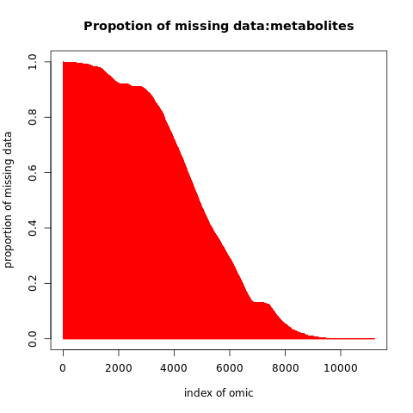
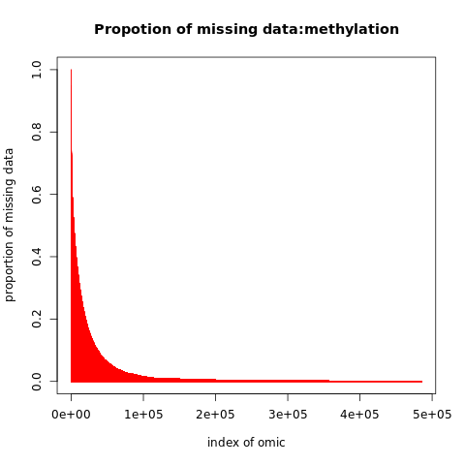

Slide 8
Introduction: Research goals
Investigate markers at each OMIC level associated with short term and long-term (really medium-term) exposure
Use different methods for identifying ‘interesting’ markers. How do these methods compare?
OMIC integration and biological interpretation

Slide 9
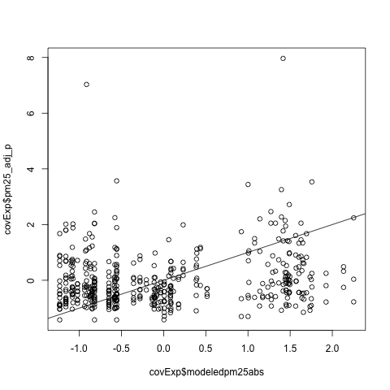
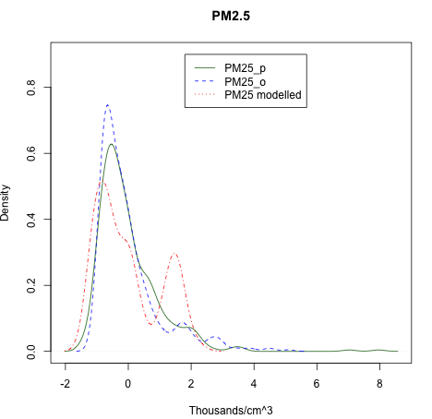
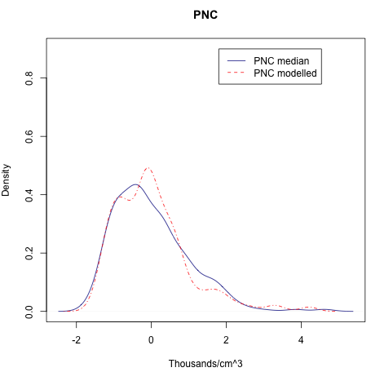
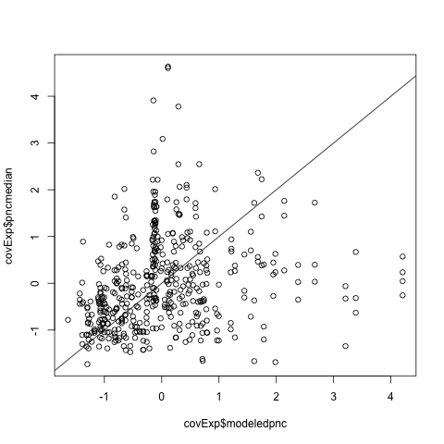
Exposures
PM25
PNC
But - plotting modelled (x axis) against measured (y axis) shows there is little correlation within-subject
Distributions of measured / modelled exposures are similar...

Slide 10
Feature selection
2

Slide 11
Feature selection
Three methods for selecting ‘interesting’ markers associated with TRAP exposure
Univariate
Linear mixed models to identify markers significantly associated with TRAP exposure
Multivariate - Bolasso
Penalised multiple regression with stability analysis to identify markers consistently selected in multivariate models at different levels of penalisation
Multivariate - Bayesian
Variational approximations to MCMC using varBVS package. Gives posterior likelihood of inclusion in model.

Slide 12
The univariate model
Simple linear mixed model:
Y[omic] ~ [1 | ID] + [1|random effs] + [covariates] + exposure
ID as a random effect to remove between-subject variance Random effects = technical confounders (batch etc) Covariates = confounders such as age, BMI, caffeine etc. Exposure = either short-term measurement
When investigating short term exposure, long-term exposure was controlled for, and vice versa.
We will report short-term results, as they are more interesting (almost no significant long-term results found)

Slide 13
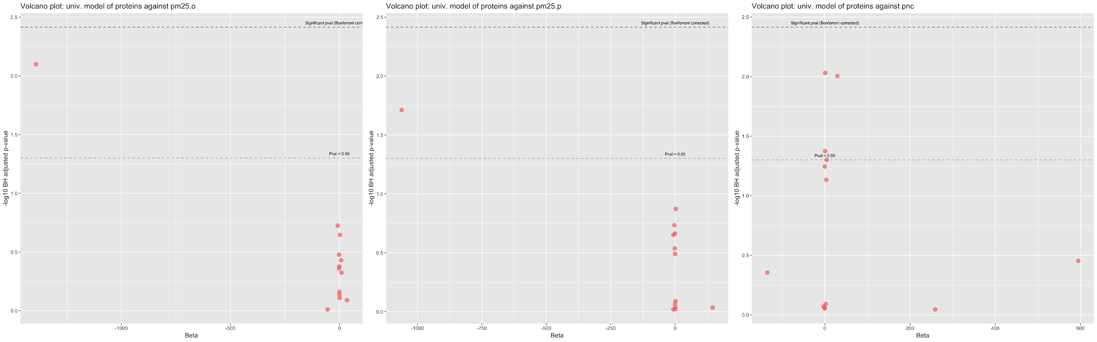
Univariate variable selection: Proteins
No significant proteins identified after FDR correction
(of 8 proteins total)

Slide 14
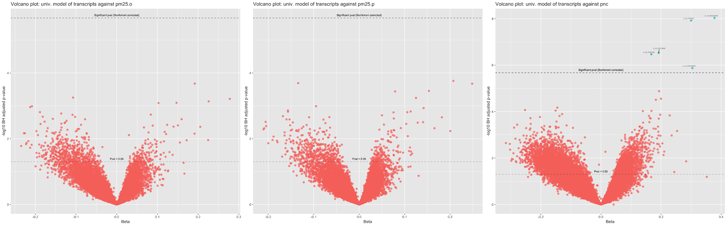
Univariate variable selection: Transcripts
5 significant transcripts identified after FDR correction (Benjamini-Hochberg) (all associated with PNC)

Slide 15
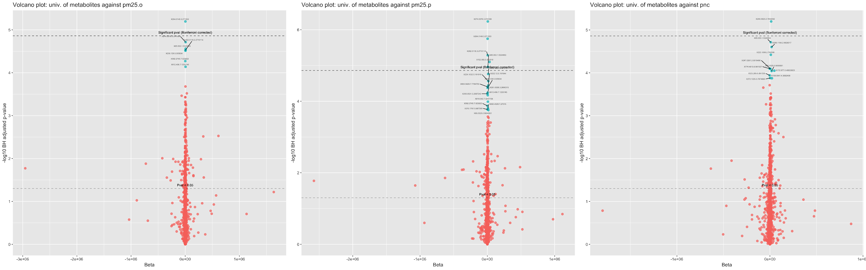
Univariate variable selection: Metabolites
27 significant metabolites identified after FDR correction 8 associated with both TRAPs
Notes:
There is an overlap of 8

Slide 16
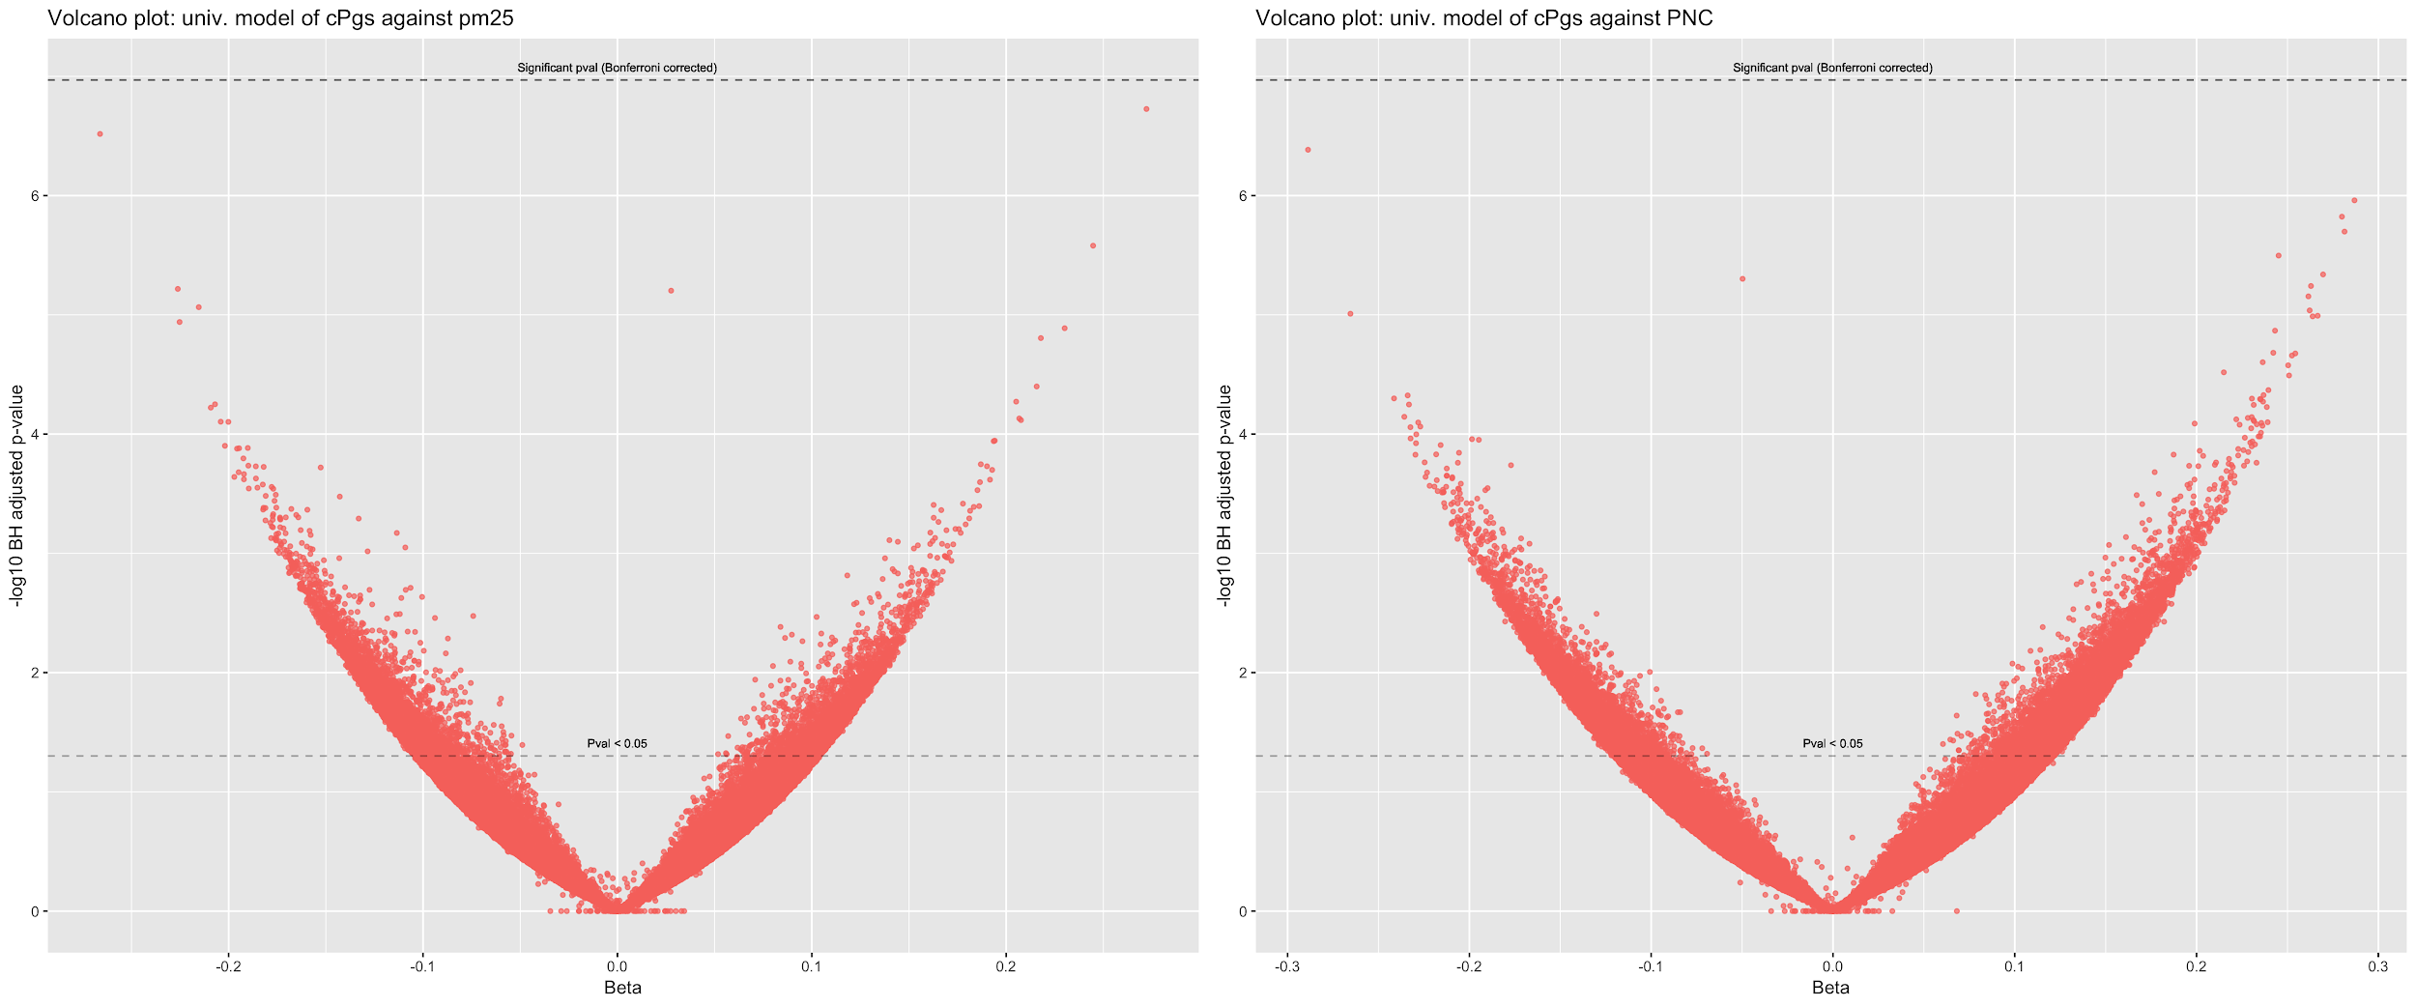
Univariate variable selection: Methylation
No significant methylation sites identified after FDR correction

Slide 17
The Bolasso model
Penalised multivariate model
Y[exposure] ~ X[Full OMIC data set] + lambda[sum of Beta coefficients]
Lasso (L1) penalised regression model run (p / n) times at a range of lambda penalty values
Variables ranked on their selection likelihood at all lambda values
Bolasso package in R allows you to pass a matrix of covariates, so denoising on random effects only required

Slide 18
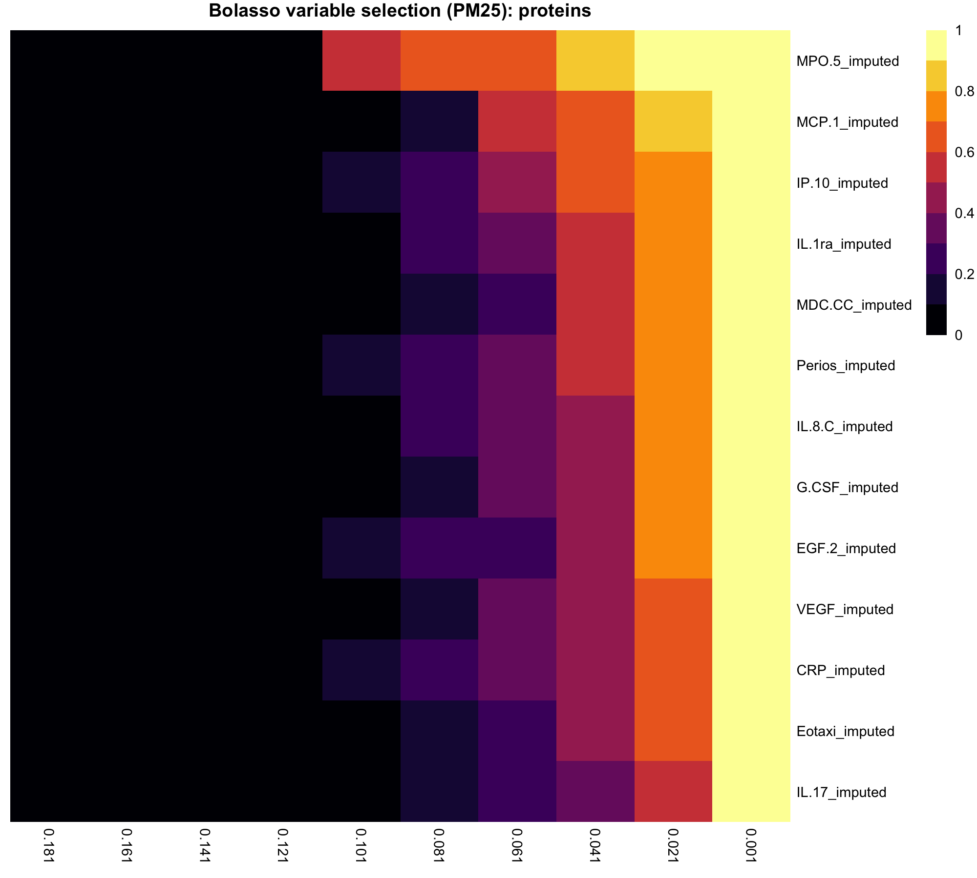
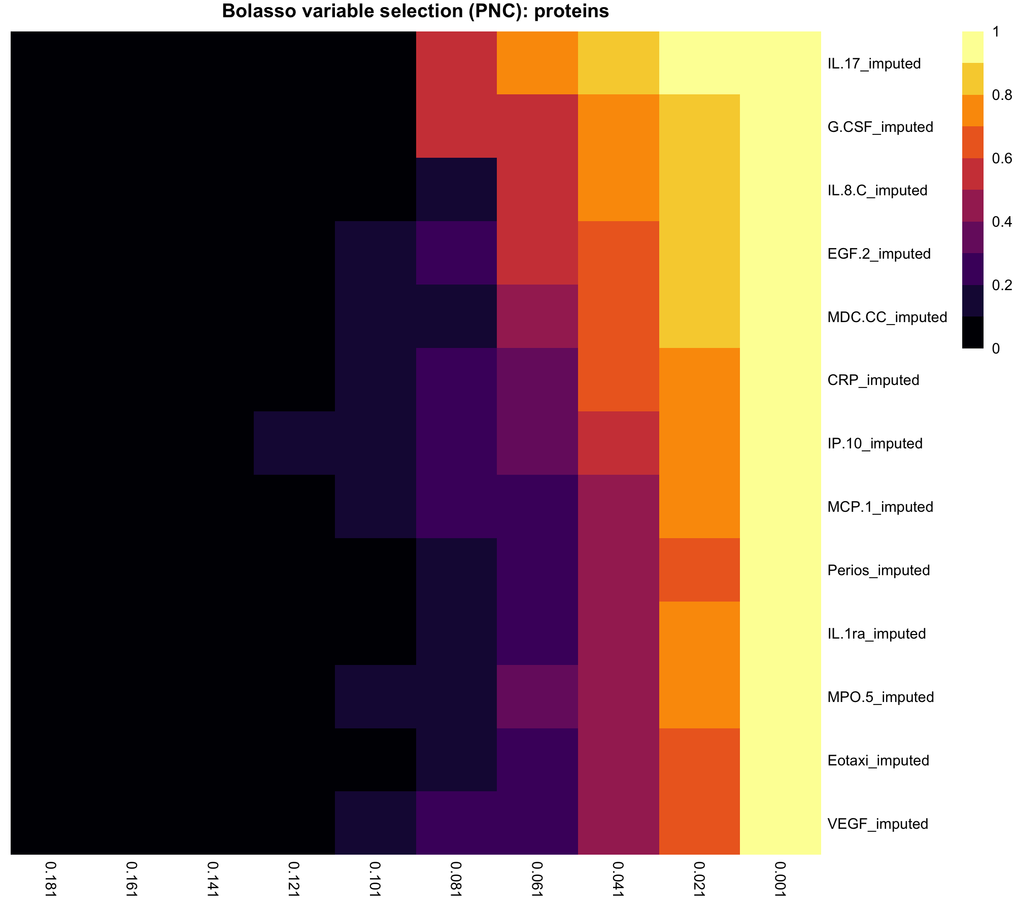
Bolasso variable selection: Proteins
Limited separation of proteins by probability inclusion in model – supports univariate findings

Slide 19
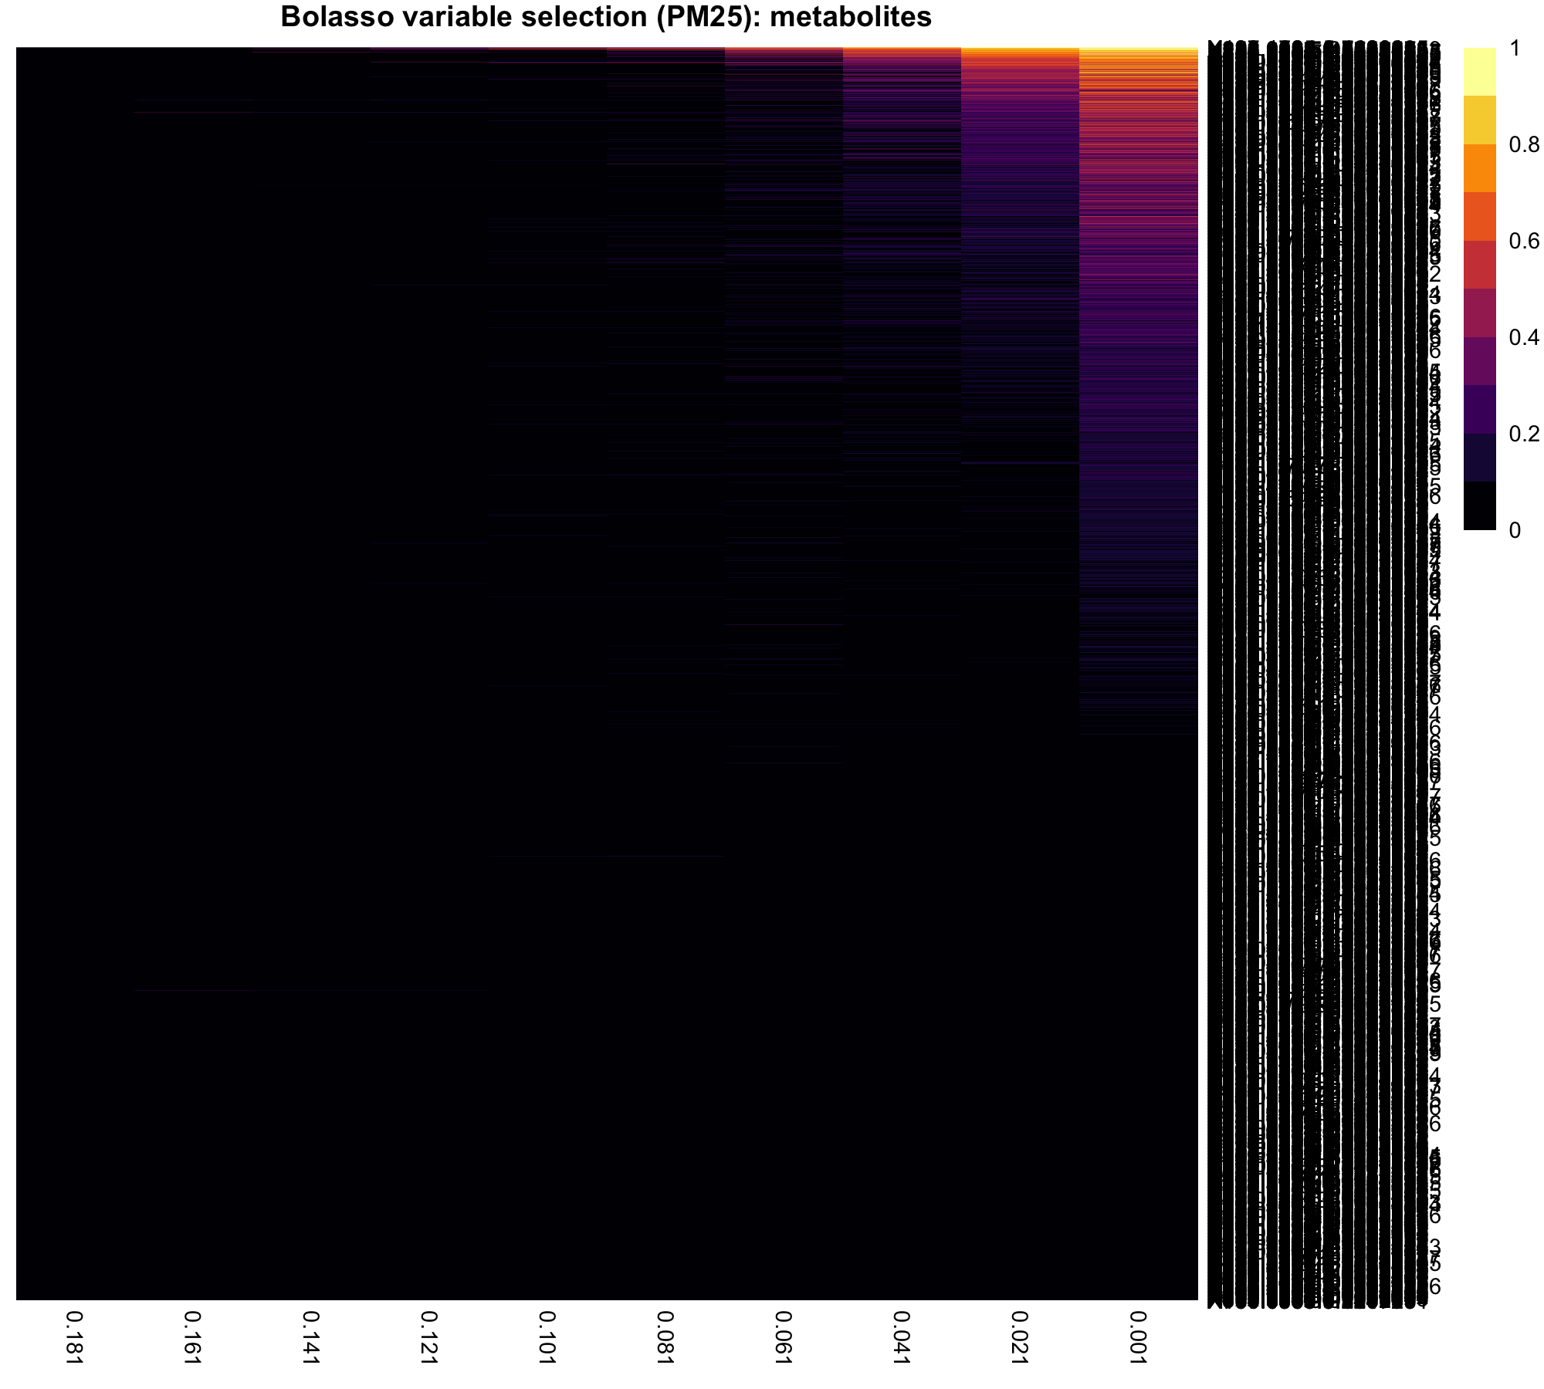
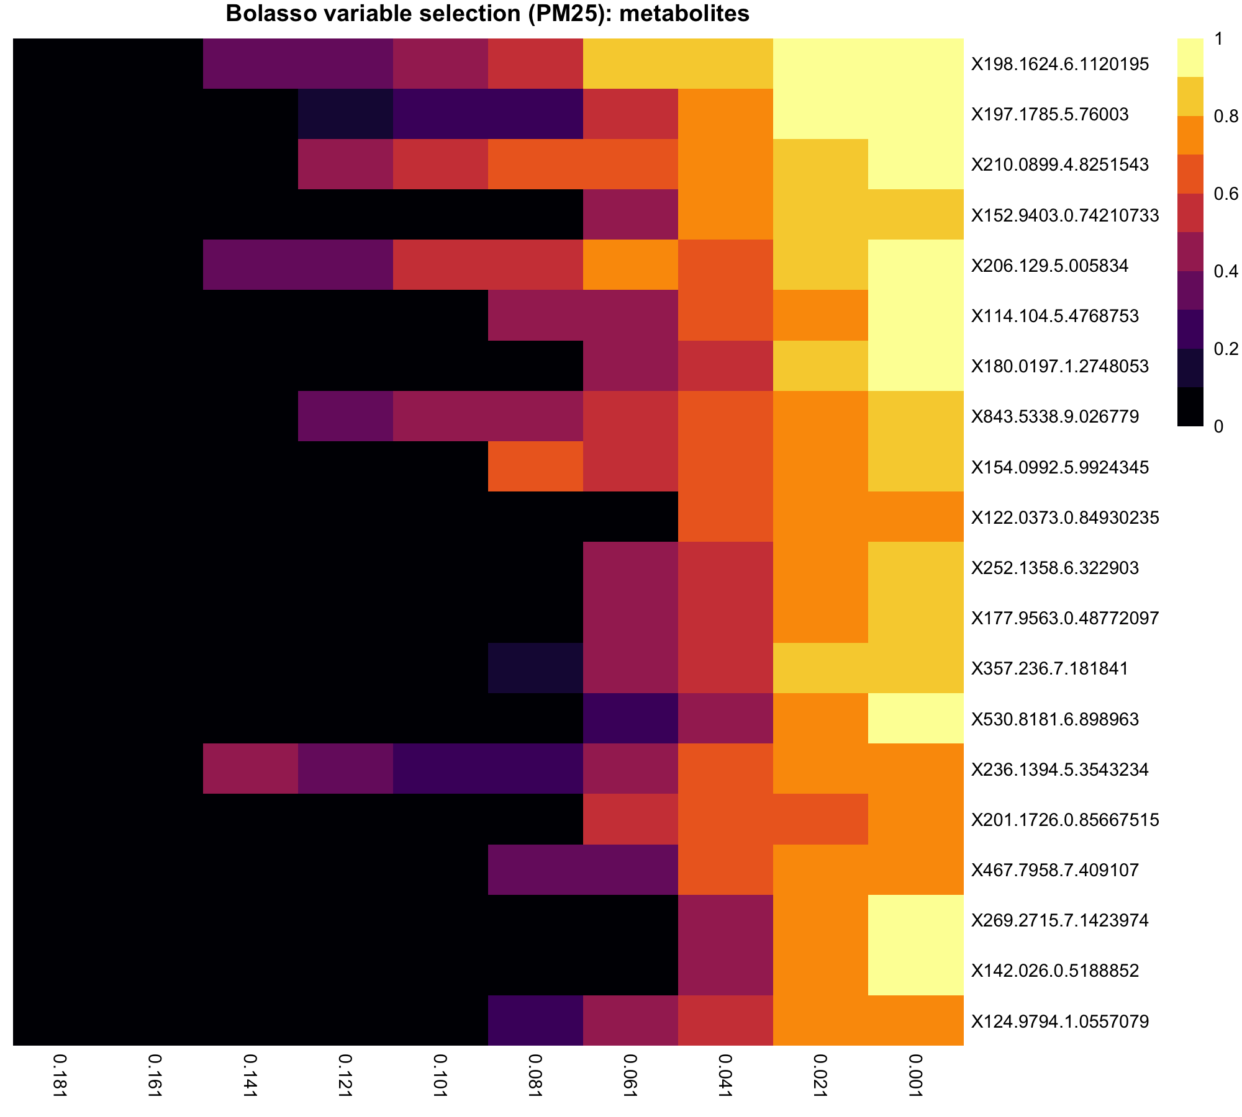
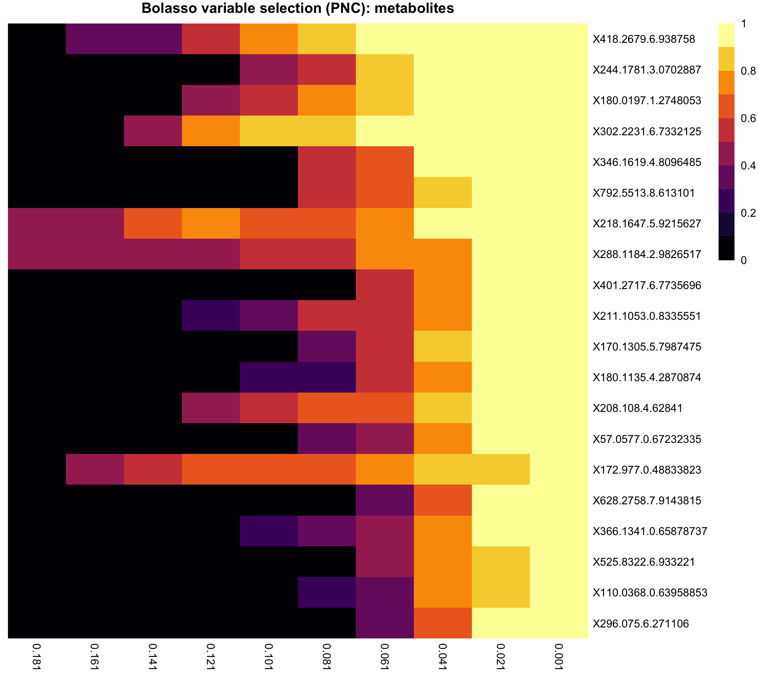
Bolasso variable selection: Metabolites

Slide 20
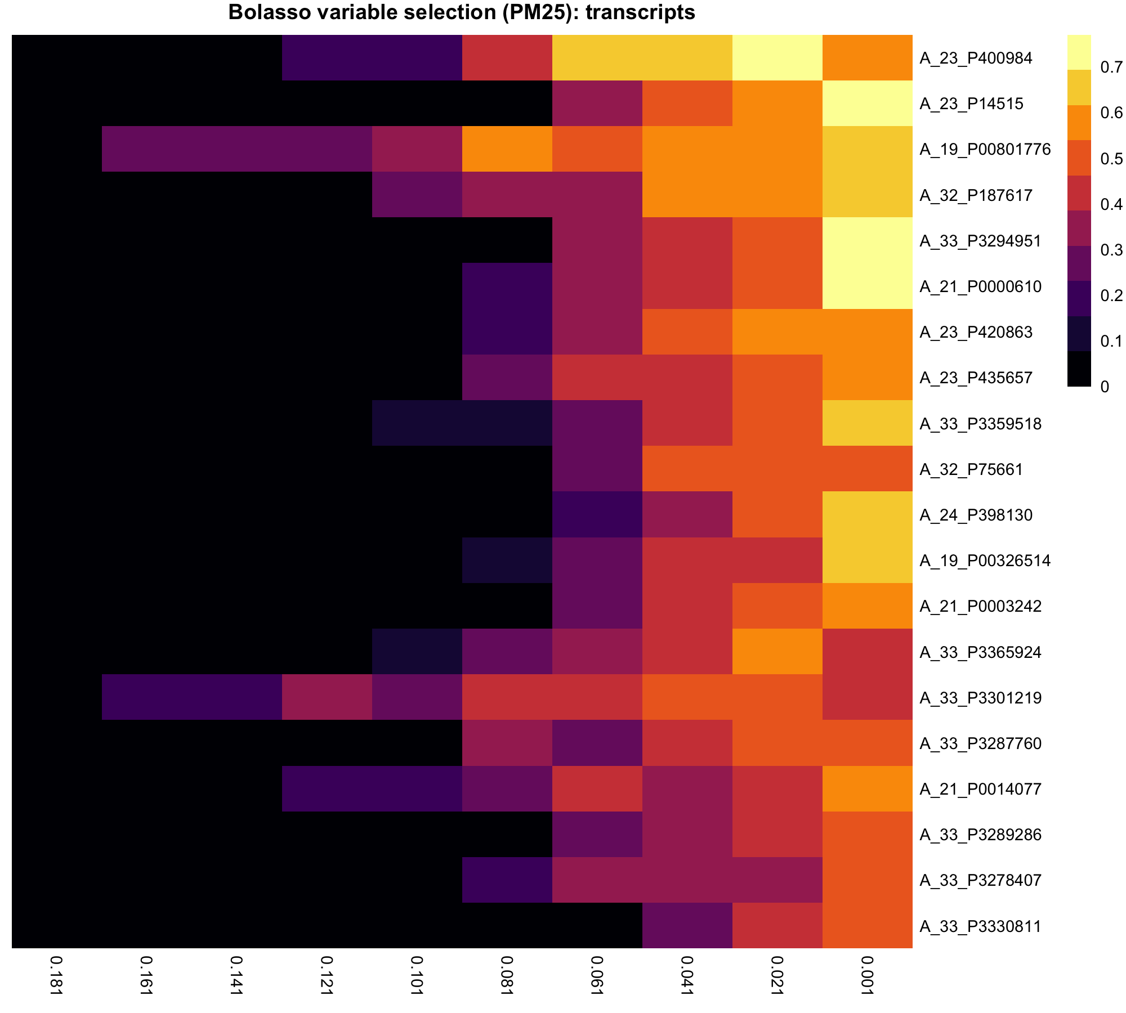
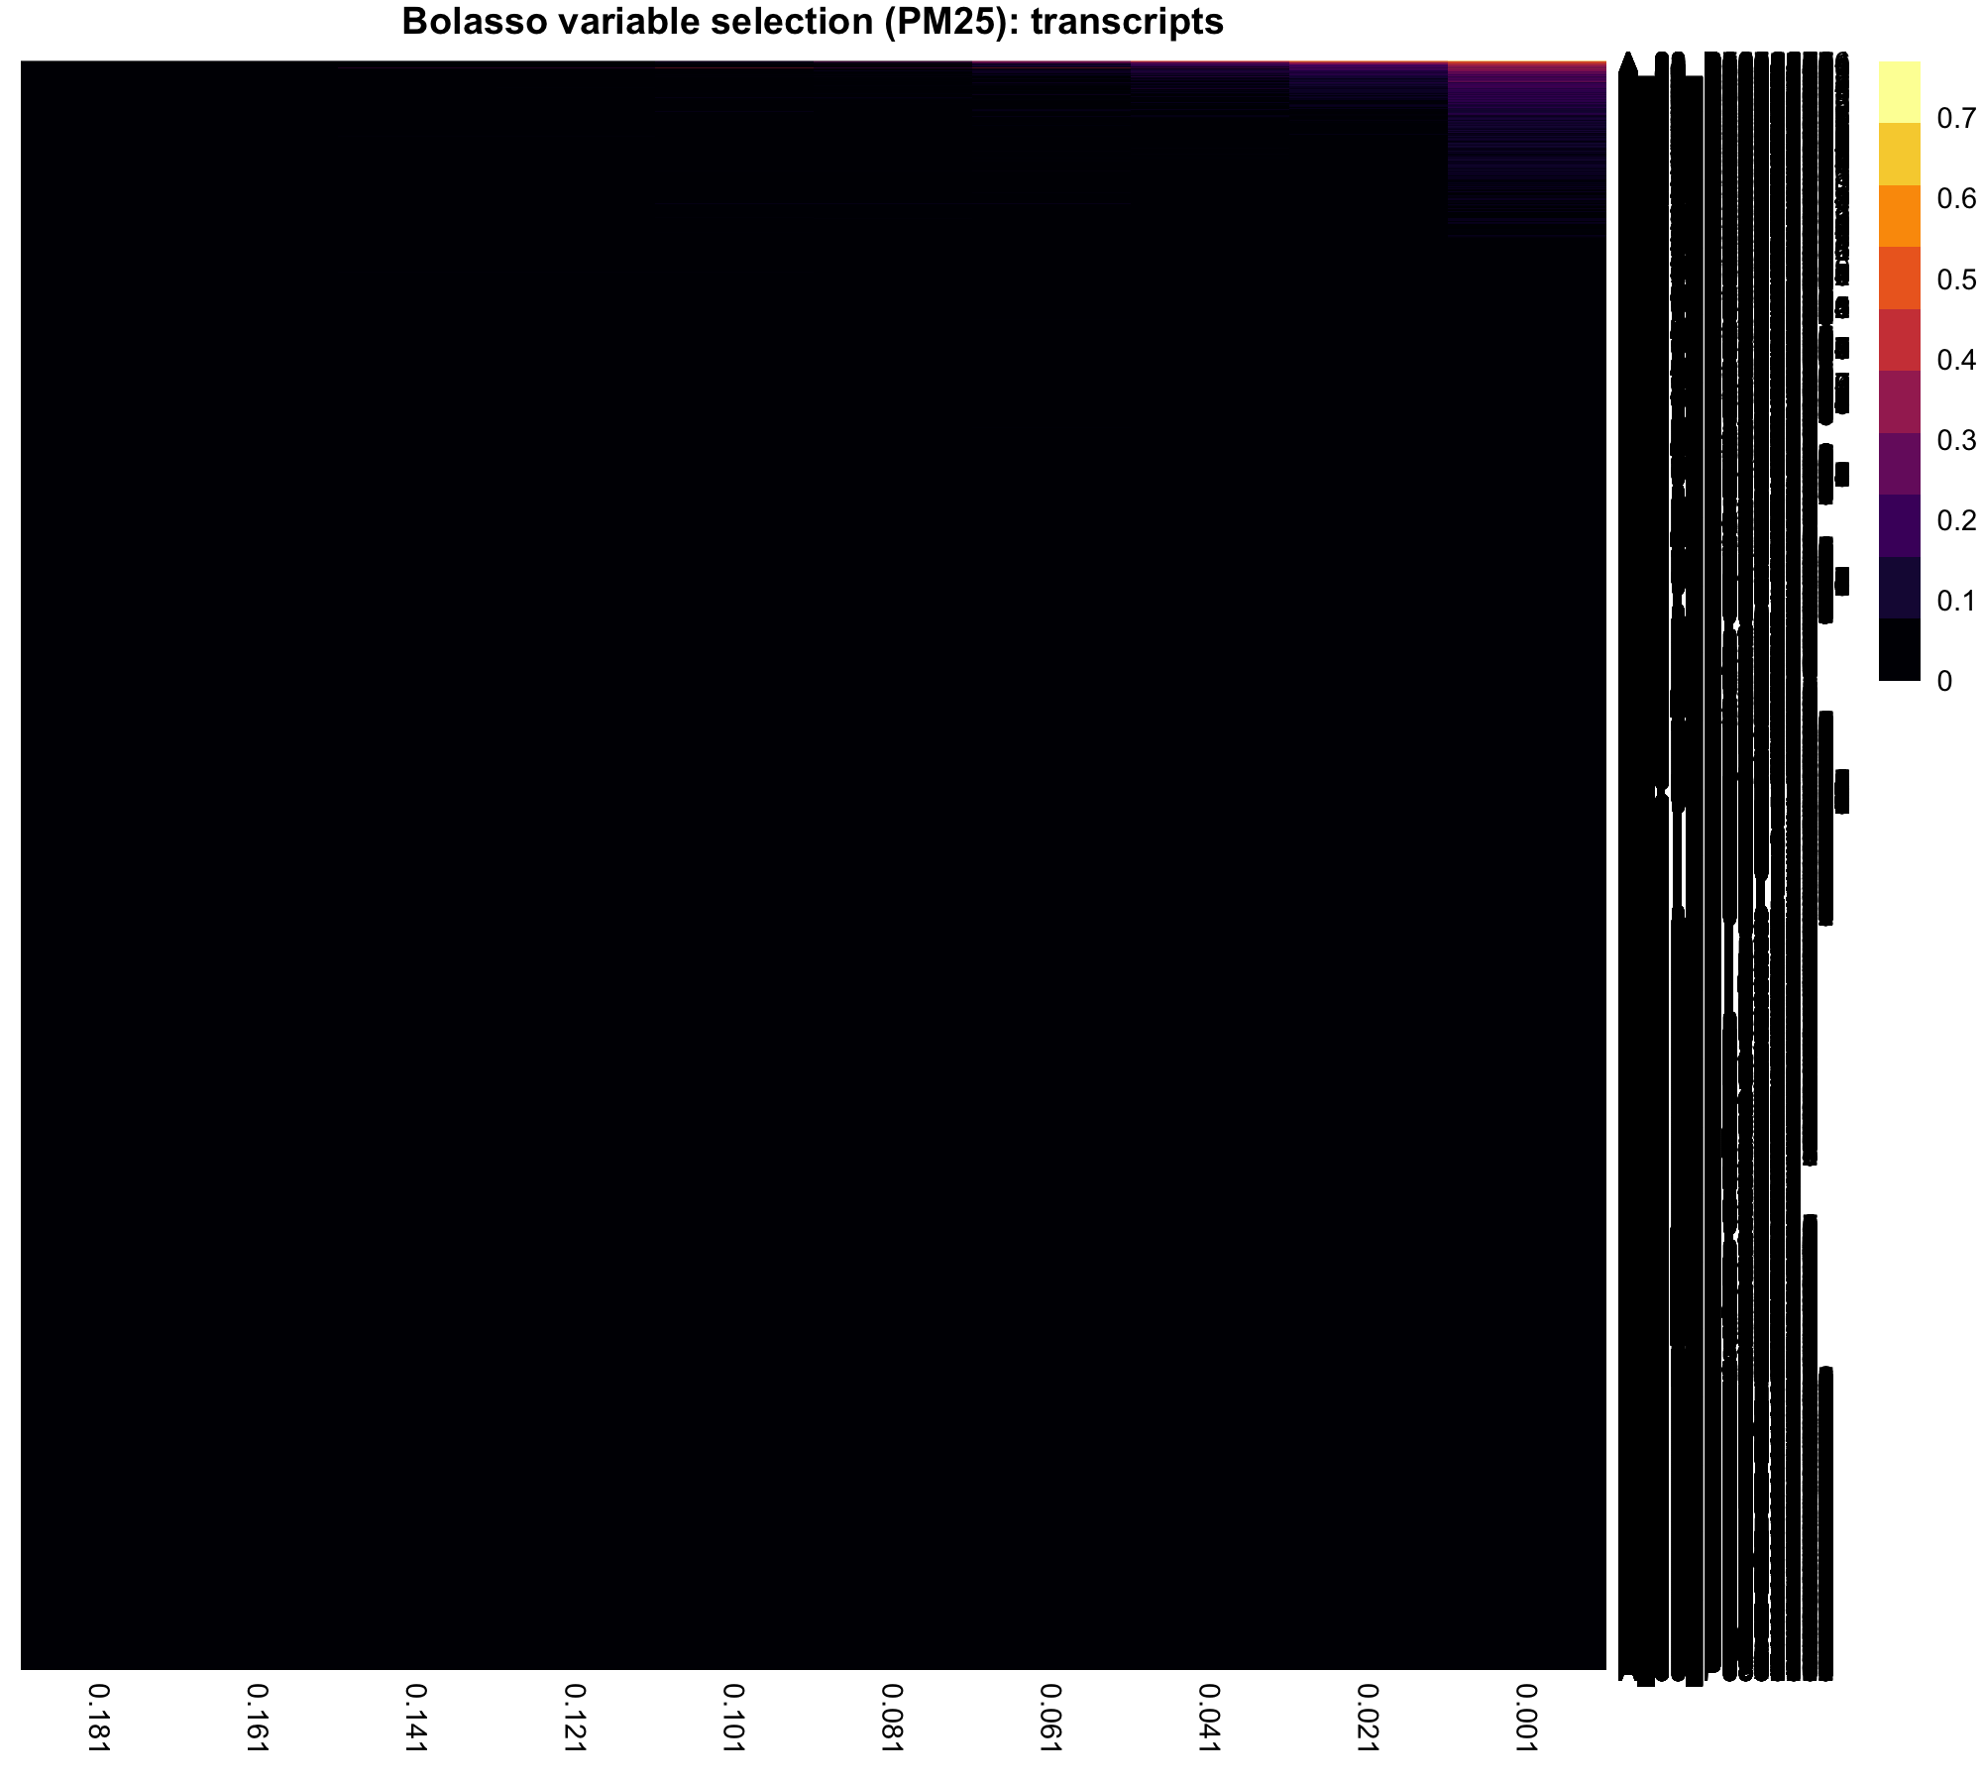
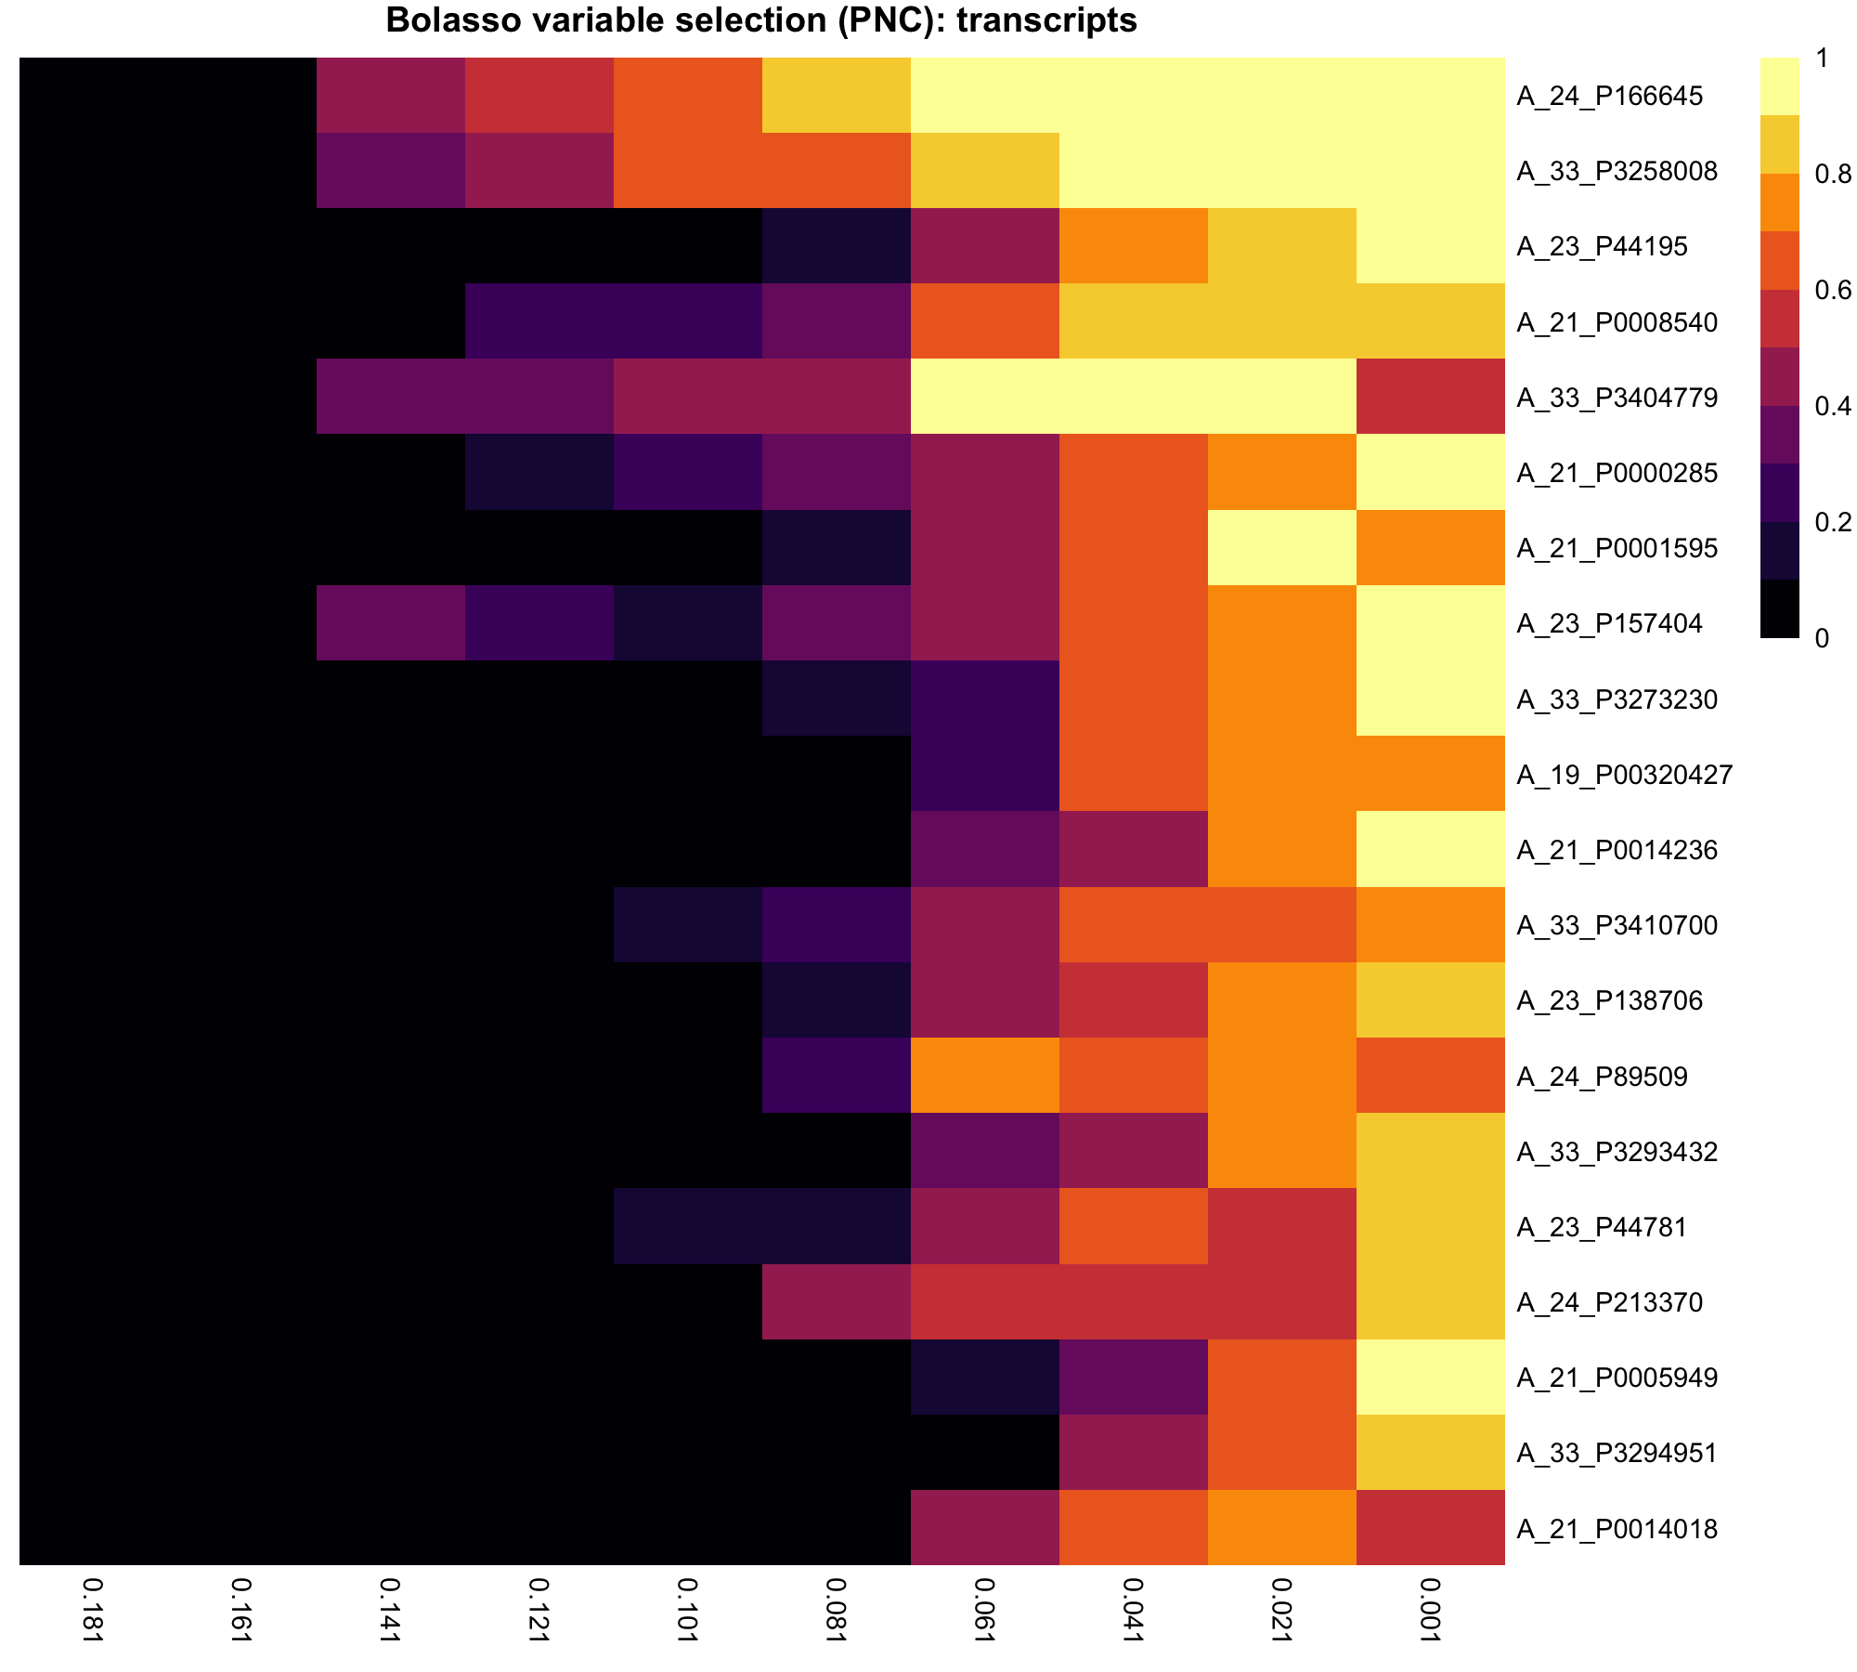
Bolasso variable selection: Transcripts

Slide 21
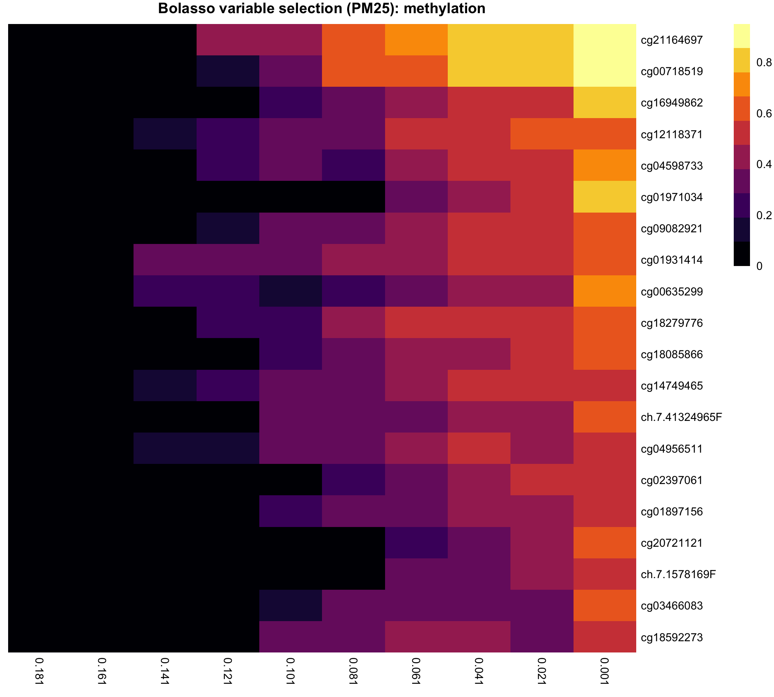
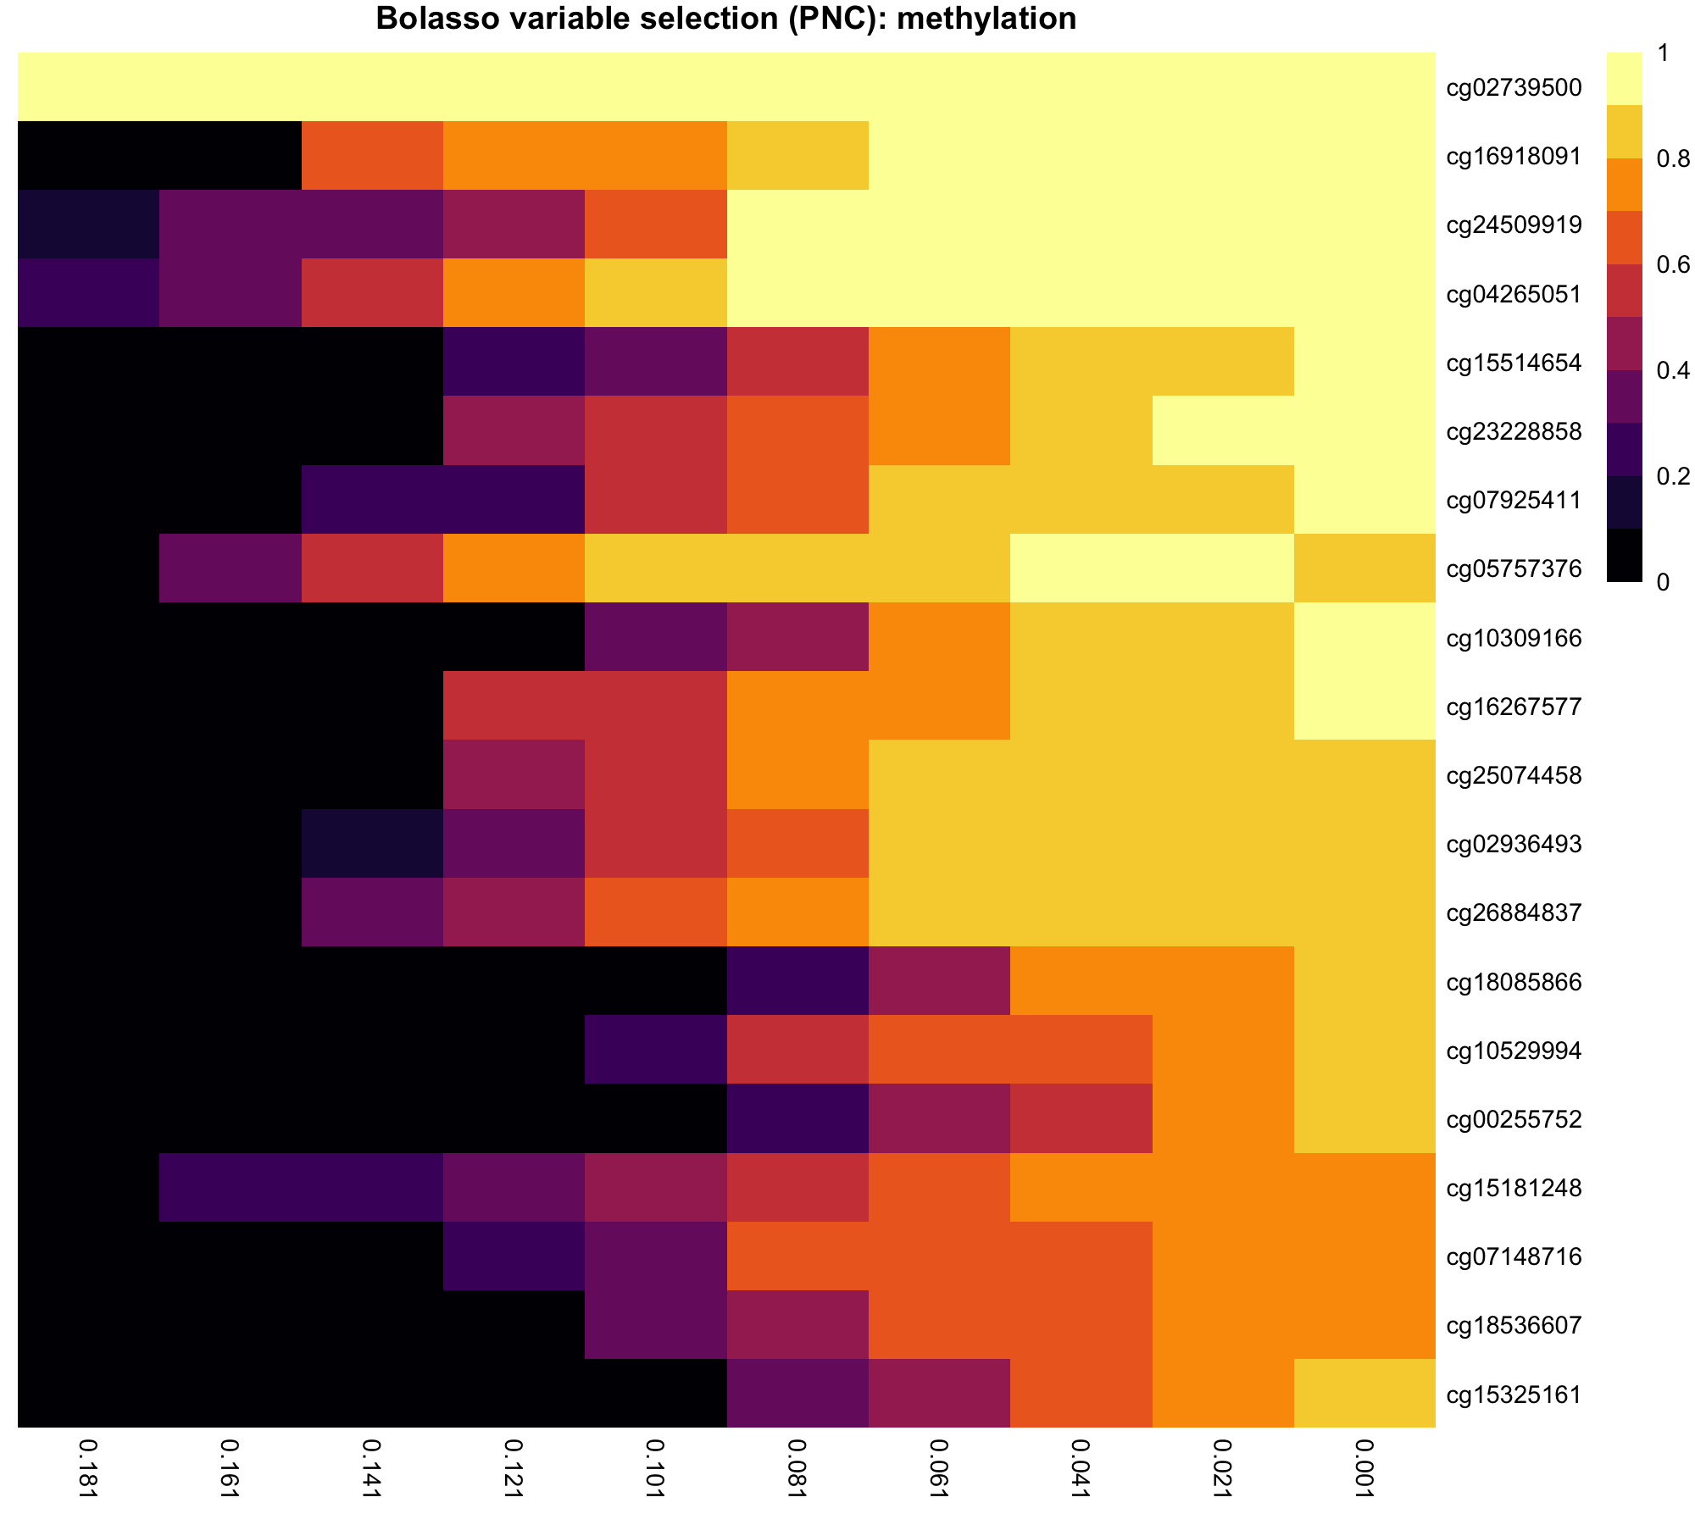
Bolasso variable selection: Methylation

Slide 22

The Bayesian model
Bayesian multivariate model
VarBVS package in R
Algorithm is based on “variational approximations” – ‘cheaper’ alternative to MCMC
Default spike and slab prior encourages sparsity
Posterior probability estimates less accurate than MCMC but models much faster

Slide 23
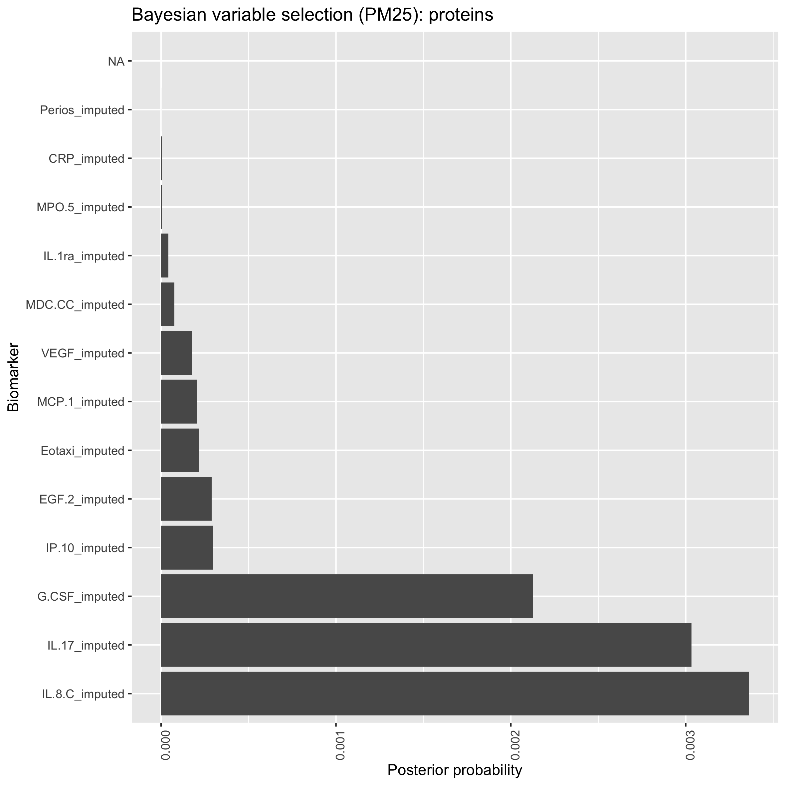
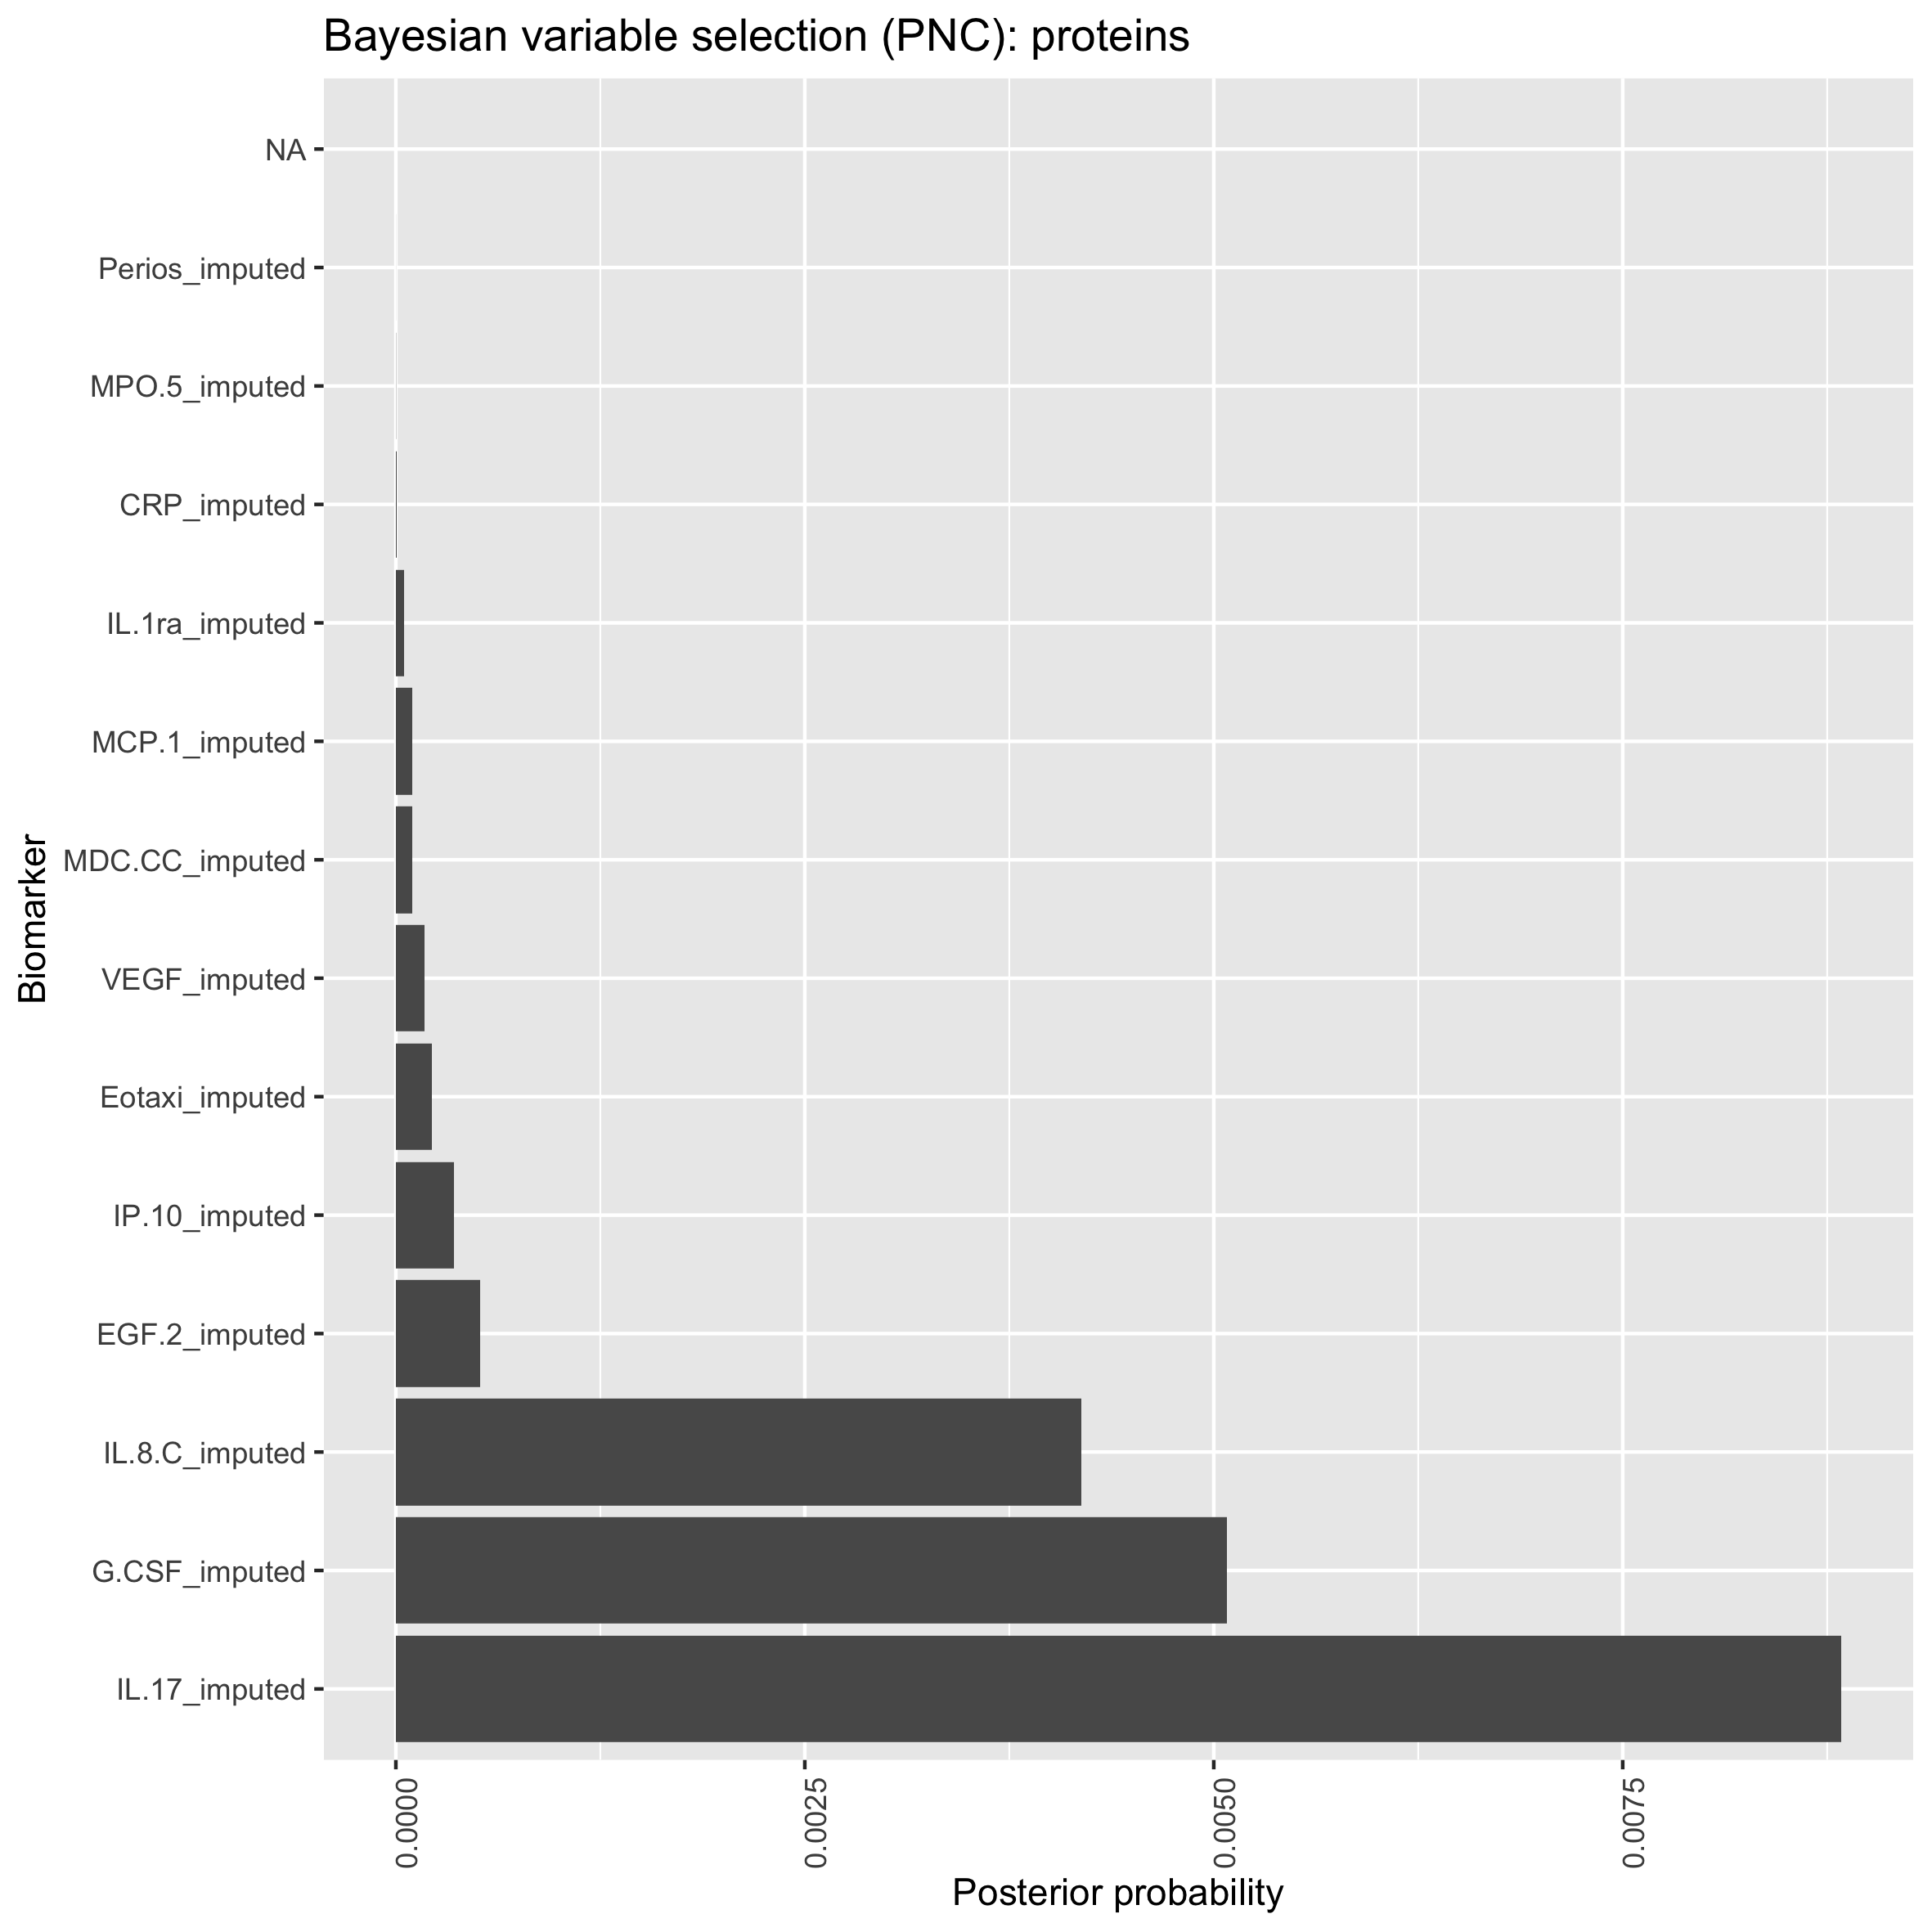
Bayesian variable selection: Proteins
PM25 all vars
PNC all vars

Slide 24
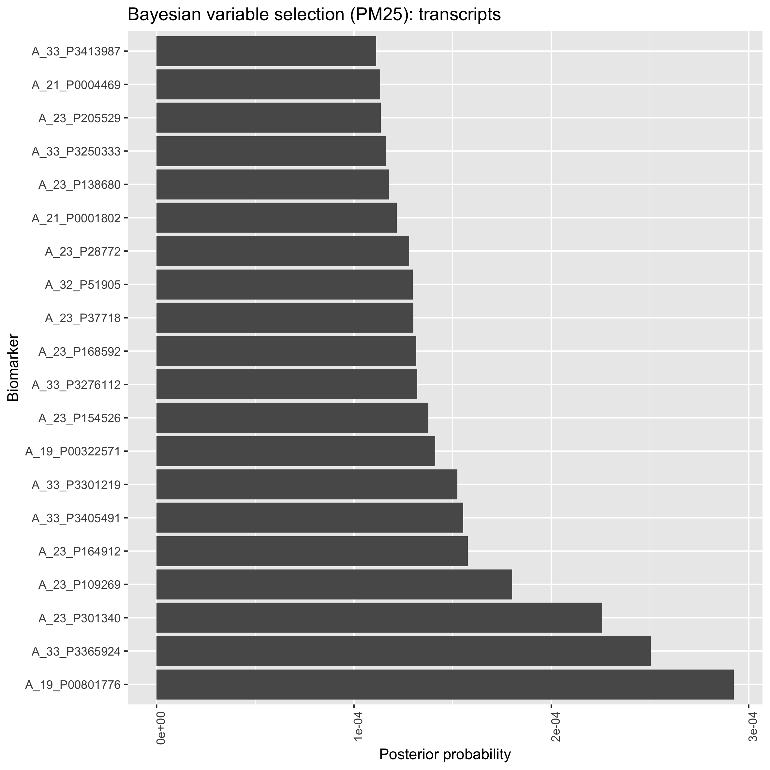
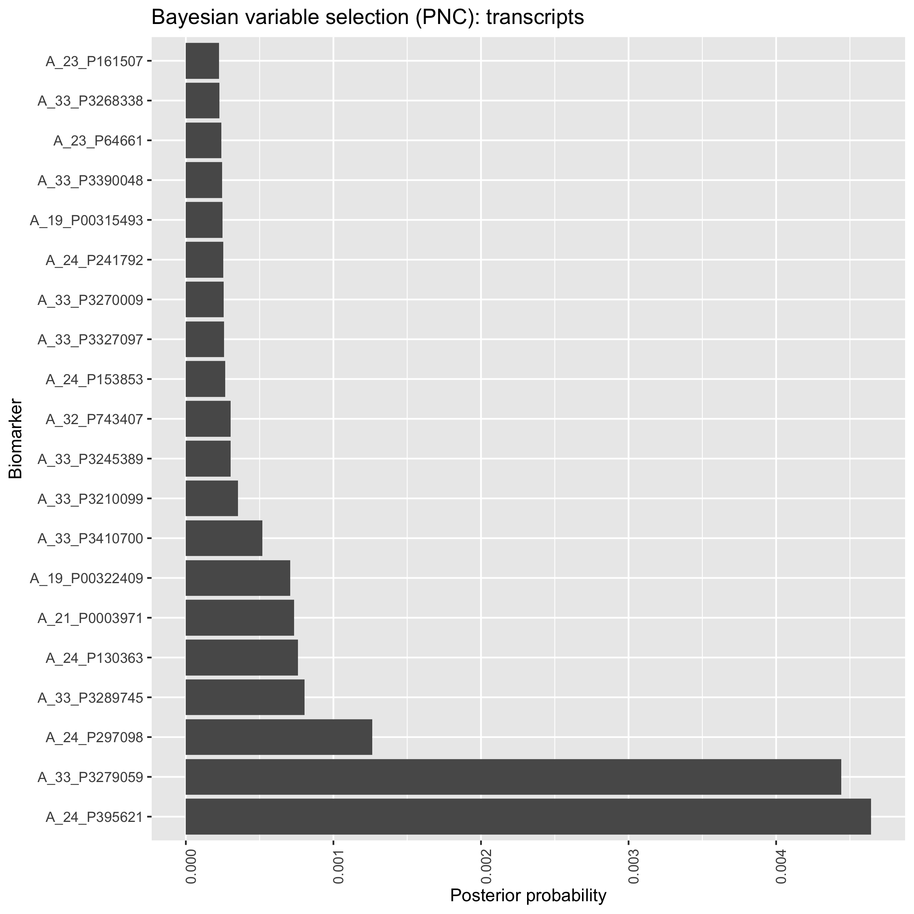
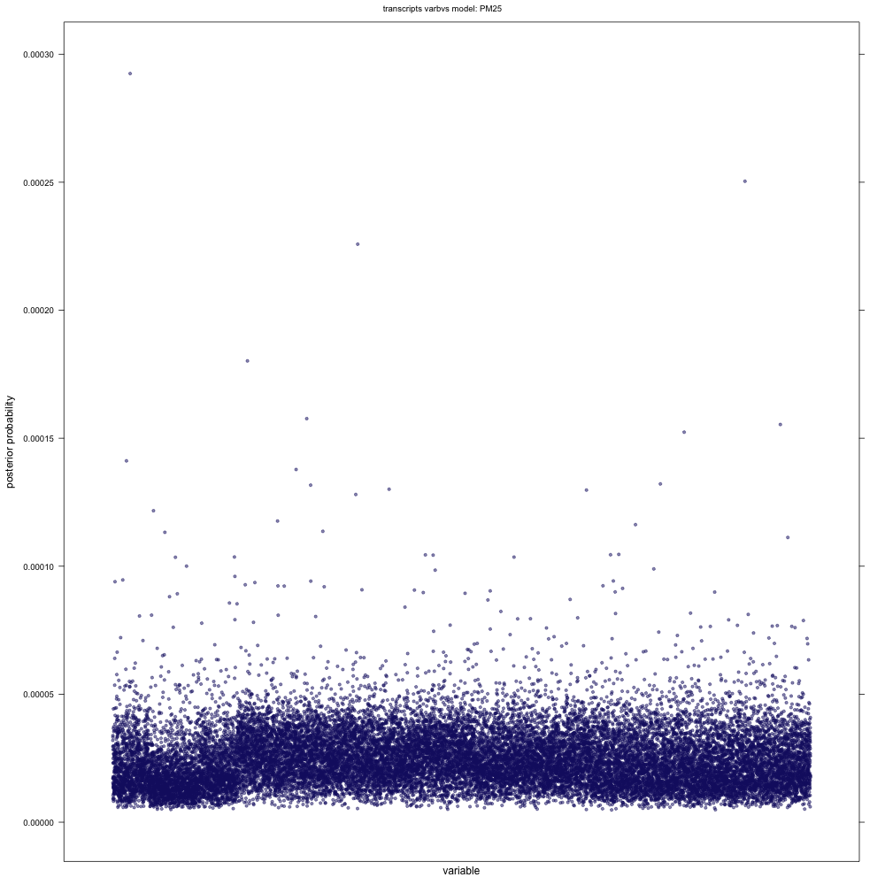
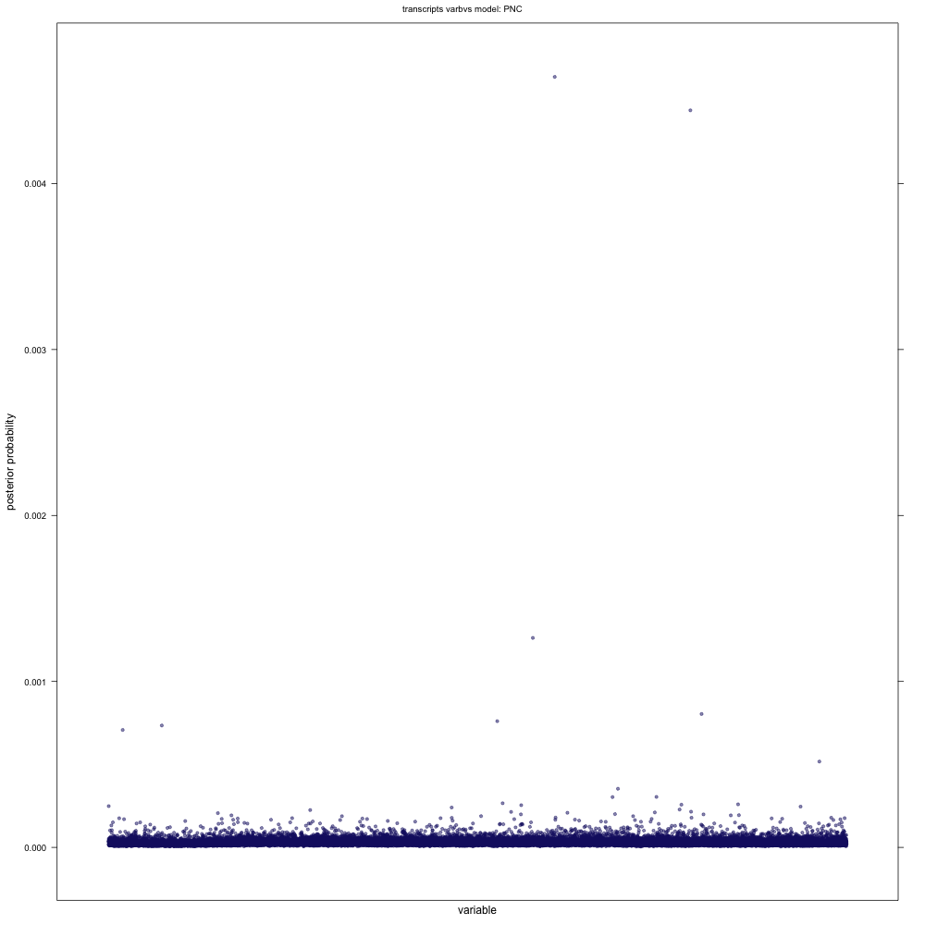
Bayesian variable selection: Transcripts
PM25 all vars
PNC all vars
Both transcripts were also identified in univariate analysis
PM25 Top 20 vars
PNC Top 20 vars

Slide 25
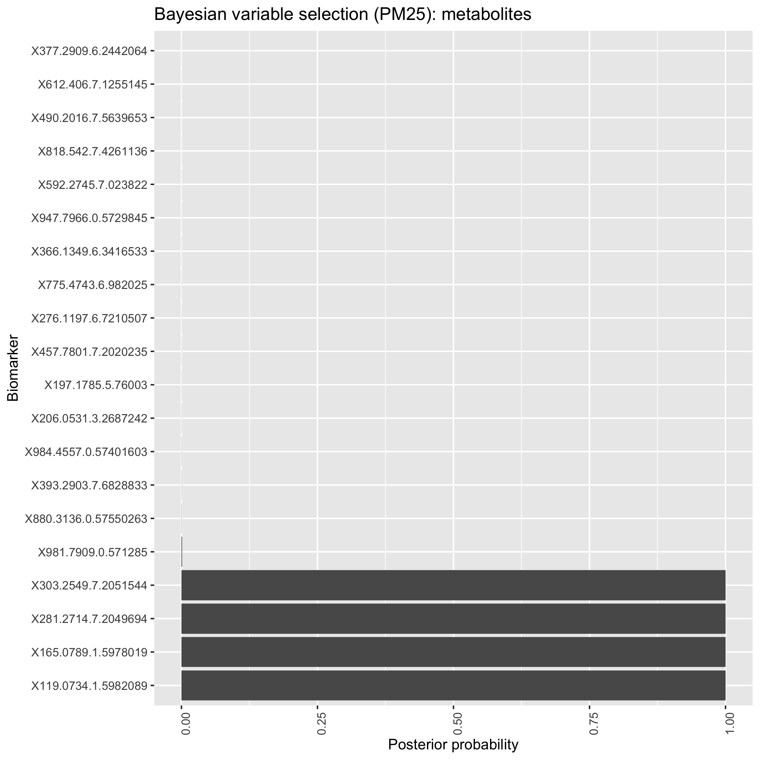
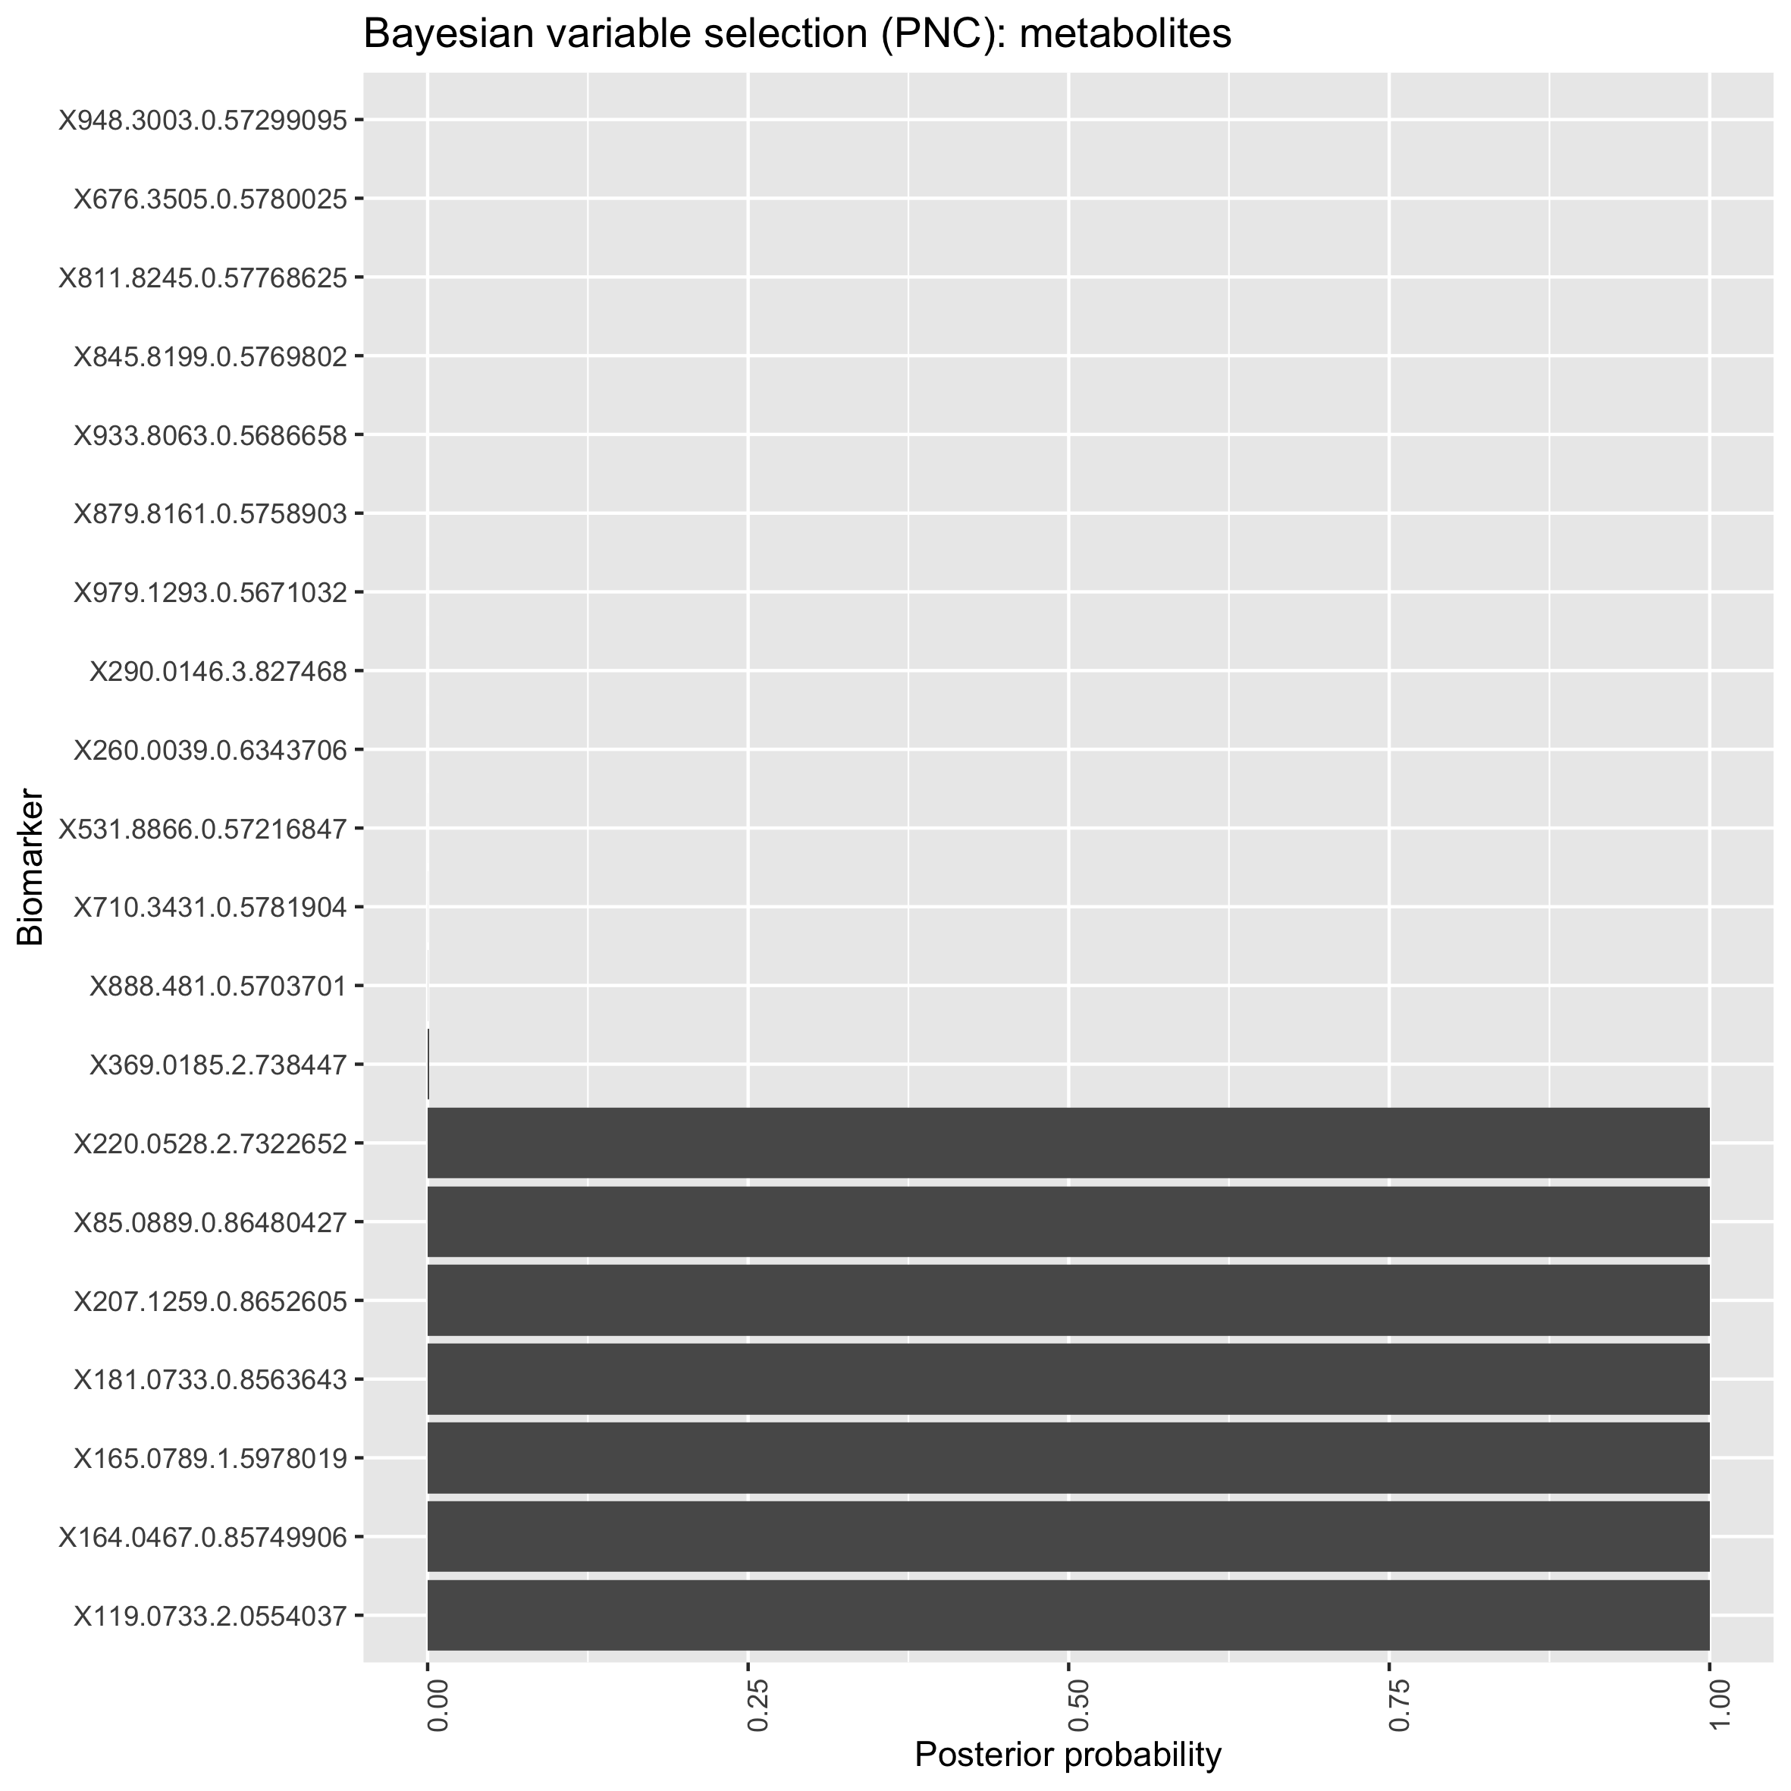
Bayesian variable selection: Metabolites
PM25 Top 20 vars
PNC Top 20 vars

Slide 26
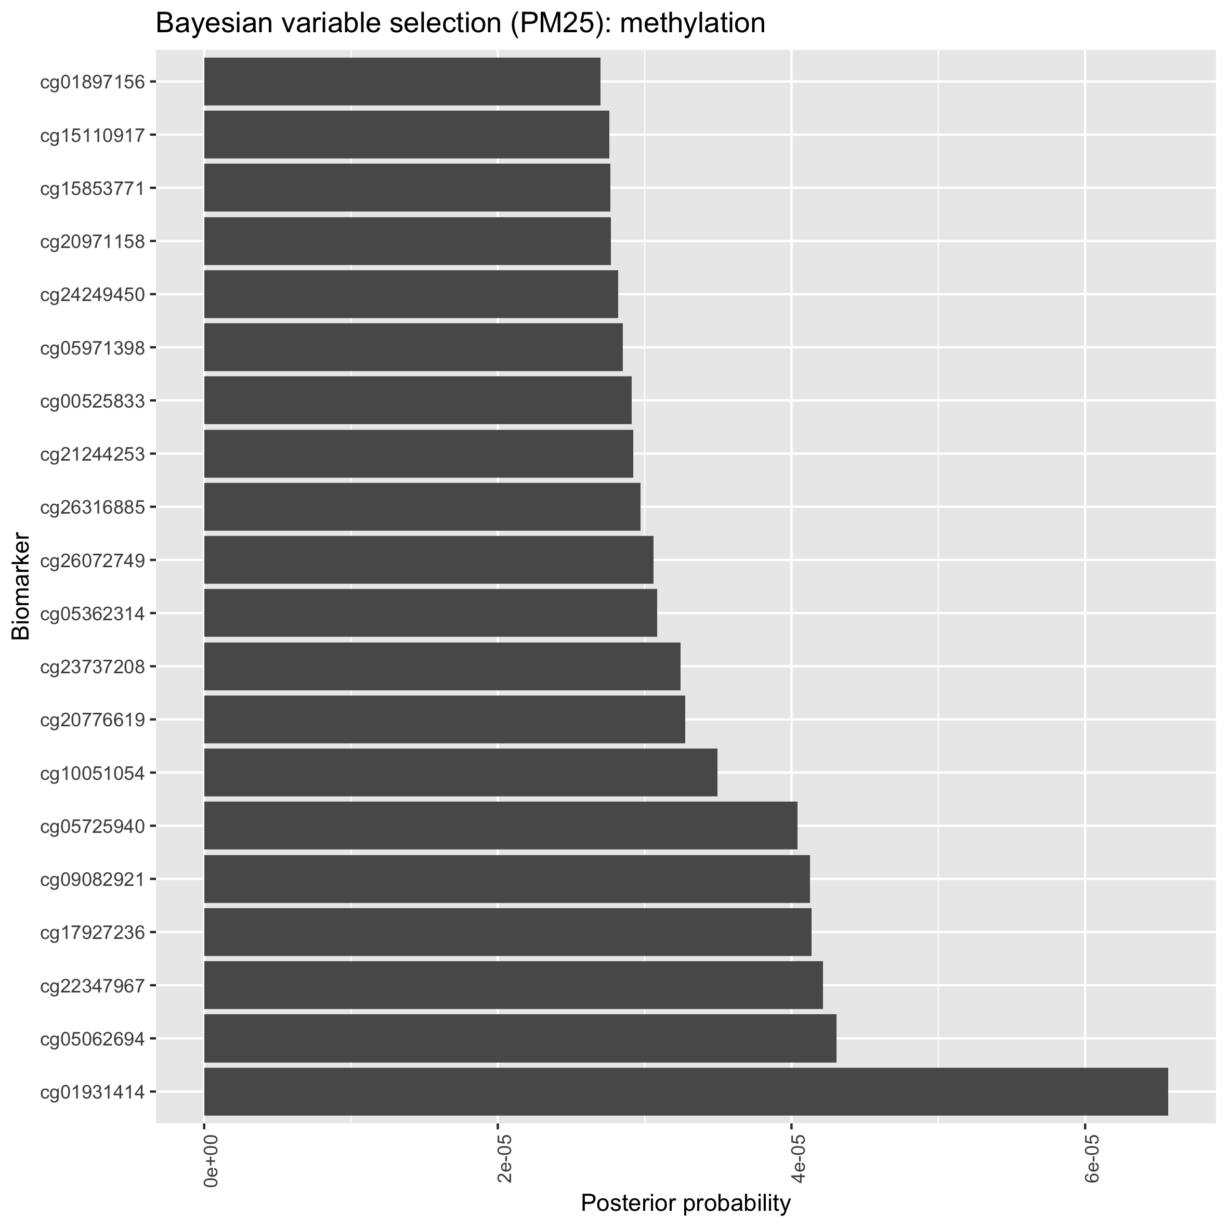

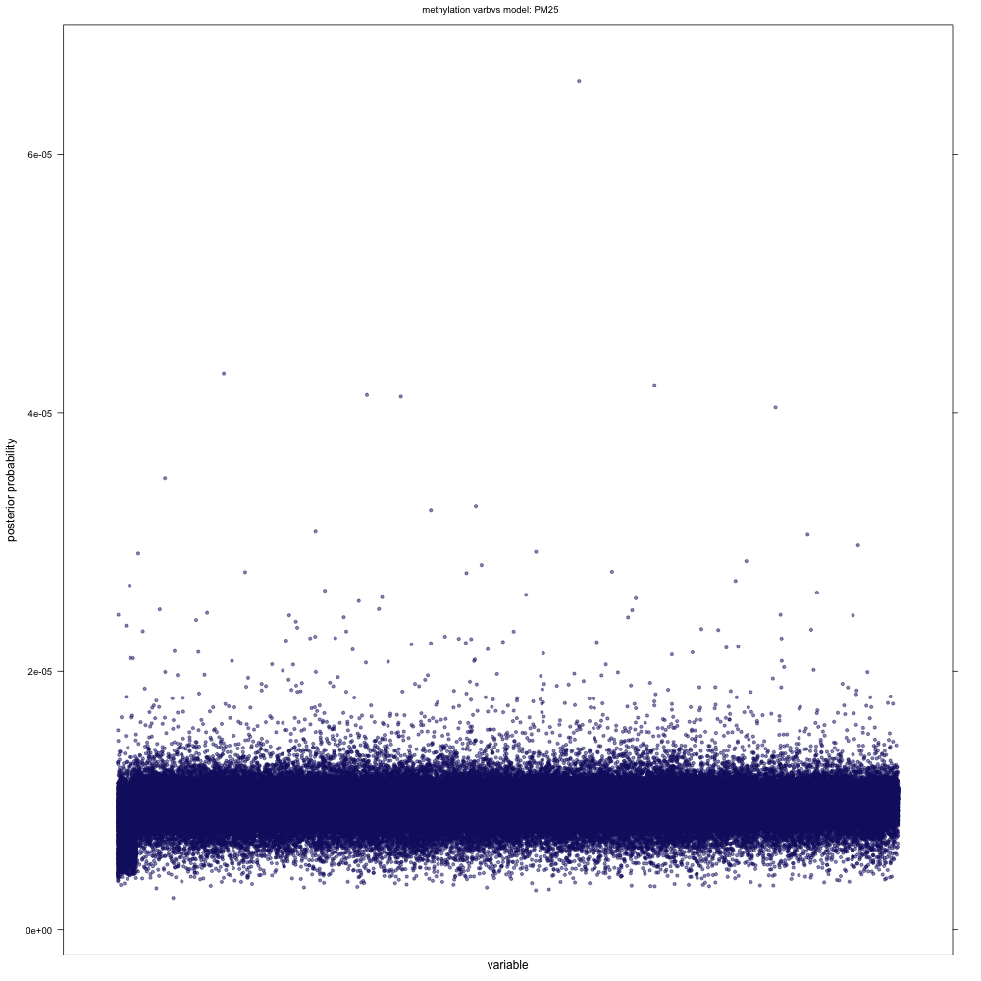
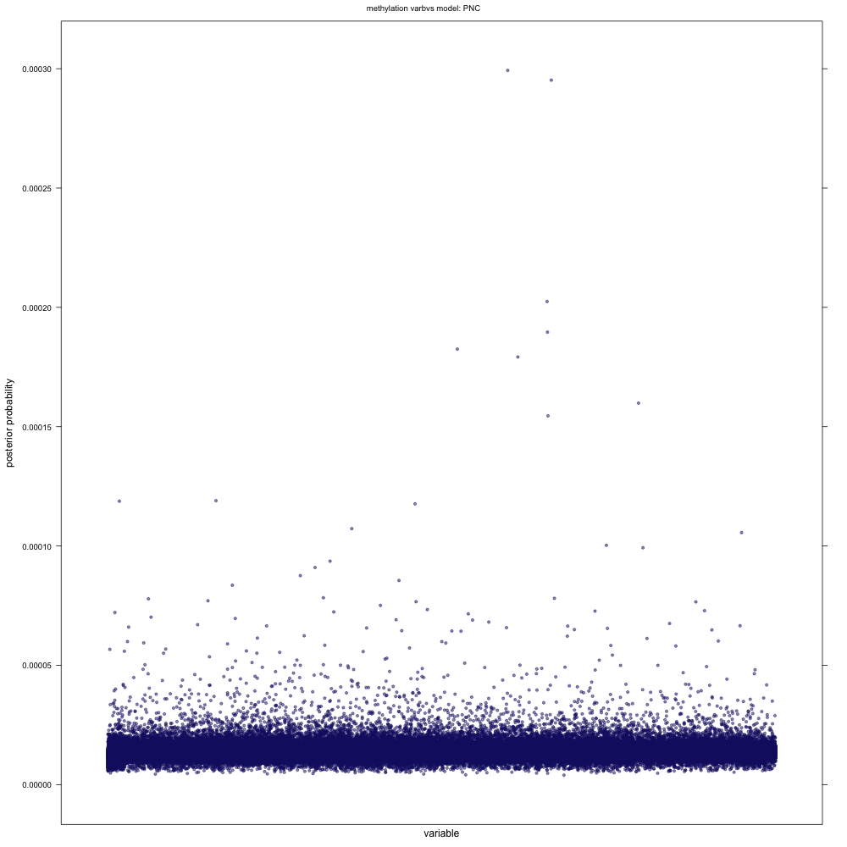
Bayesian variable selection: Methylation

Slide 27
Variable selection
Bolasso (multivariate)
131
Some overlap of ‘interesting’ selected features using different methods.
Bayesian models did select several of the same variables as univariate
(Surprisingly?) little overlap between multivariate methods
Univariate analysis found no interesting methylation sites
But – Bolasso identified one methylation marker that was selected in every PNC model at every reasonable penalty level. This marker is surely ‘interesting’.
3
6
0
21
8
11
Univariate
Bayesian (multivariate)

Slide 28
Variable selection
Univariate analysis failed to identify any significant methylates after false discovery correction
But – Bolasso identified one methylation marker that was selected in every PNC model at every penalty level. This marker is surely ‘interesting’.

Slide 29
Univariate (BVS in bold) Variable Selection: Transcript
Transcript | Gene Symbol | Gene Name | Functions
A_24_P297098 | PHF20 | PHD-finger protein 20 | Component of a histone acetyltransferase, involved in transcription regulation of MOF target genes. Upregulated after DNA damage
A_33_P3279059 | RIPK1 | Receptor (TNFRSF)-interacting serine-threonine kinase 1 | Functions in several pathways. Depending on the pathways, upregulation of RIPK1 can lead to both cell survival and cell death
A_19_P00322409 | LOC729178 | Uncharacterized LOC729178
A_24_P395621 | RUNDC1 | RUN-domain containing 1 | May play a role as p53/TP53 inhibitor, which is a classical tumour supressor, and thus may have oncogenic activity.
A_19_P00322904 | CCDC149 | coiled-coil domain containing 149 | A coiled-coil motif
Bolasso variable selection: Methylation
Methylation Probe | Associated Gene | Function
cg02739500 | NPW - Neuropeptide W | Binds and activates two G-protein coupled receptors in the central nervous system, so involved in signalling pathways. Stimulates water drinking and food intake. May play a role in the hypothalamic response to stress
Notes:
*transcripts - all (+) betas

Slide 30
OMIC integration
3

Slide 31
Network analysis
Marginal and conditional networks built for all OMICs features selected by each variable selection method
Edge thickness represents strength of association
Bootstrapped resampling for edge stability
Looking for:
Inter-OMIC edges (integration)
What do the networks show us about the interrelationships of the selected markers?

Slide 32
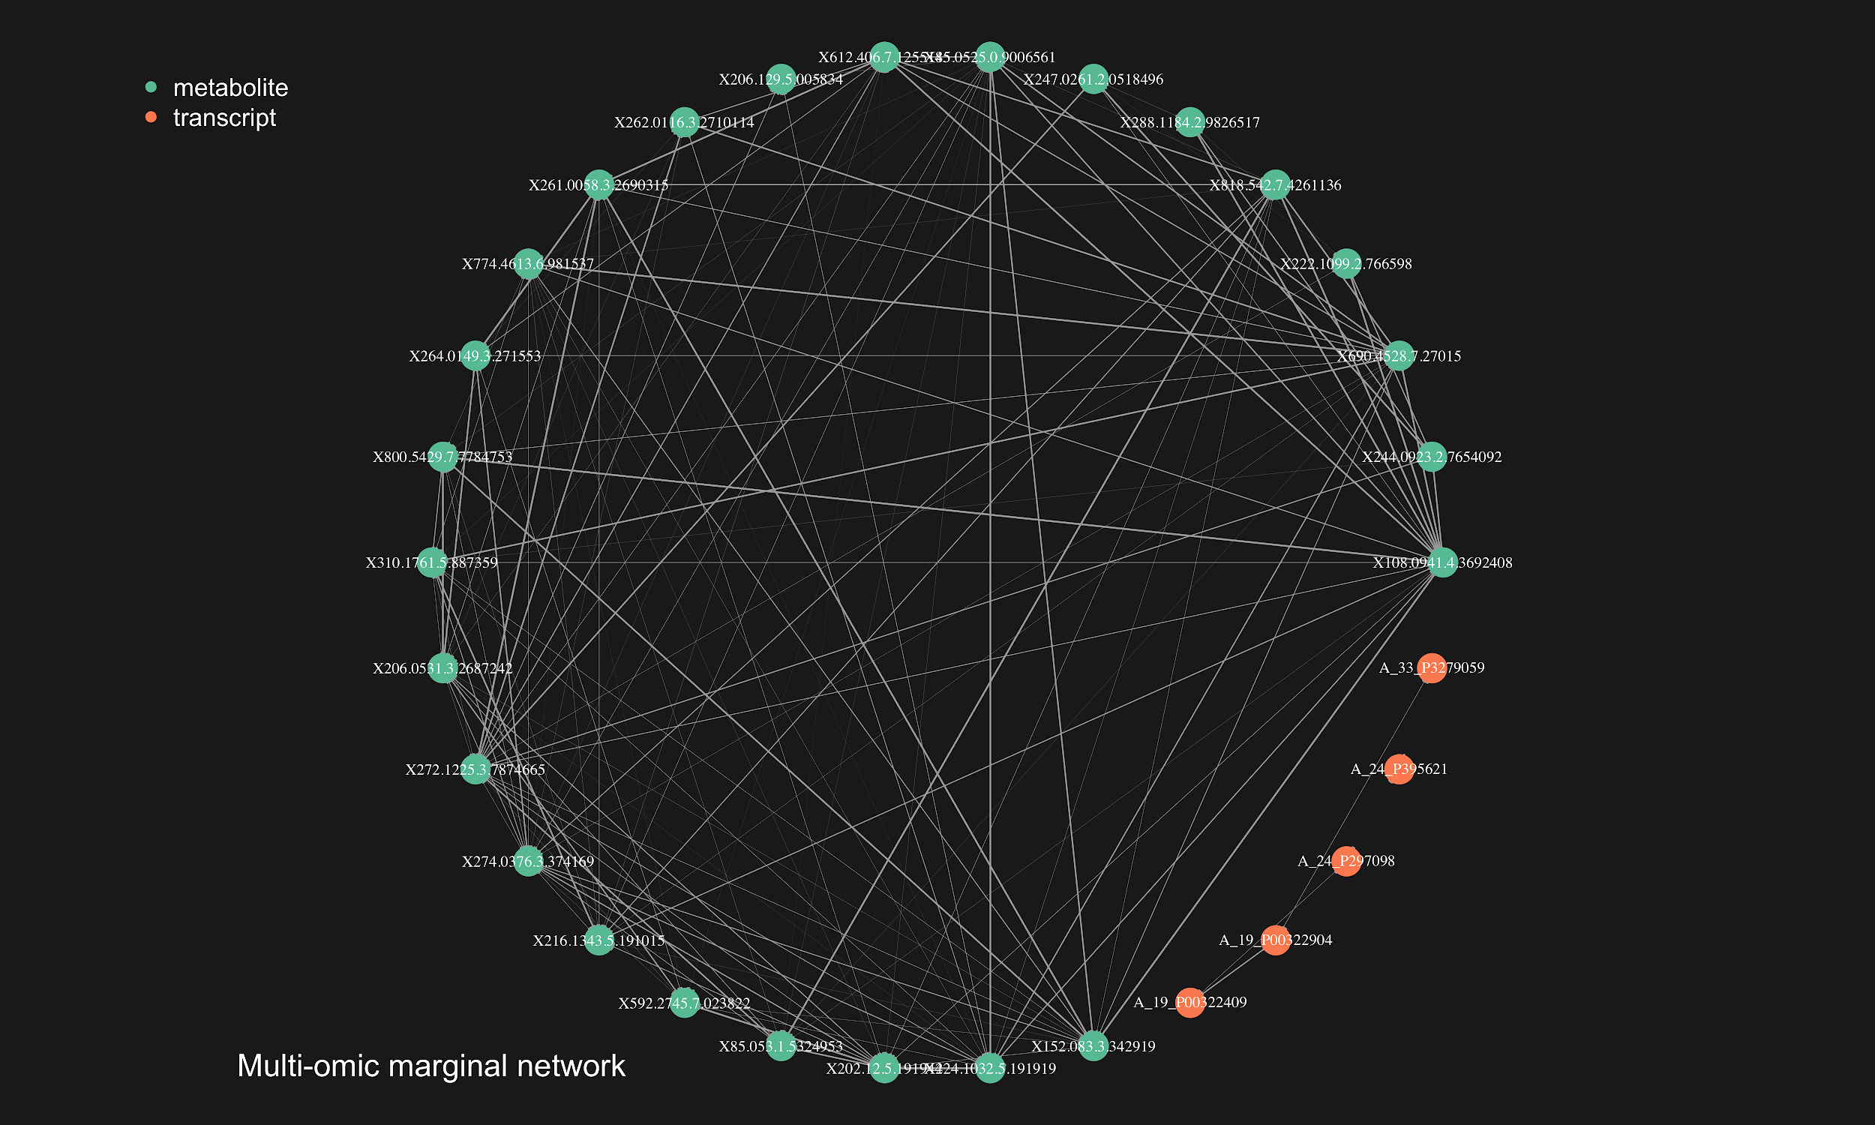
UNIVARIATE Selected variables
Marginal
Selected features are very highly correlated.
May be useful for functional analysis, but likely limited predictive power in a multivariate model.

Slide 33
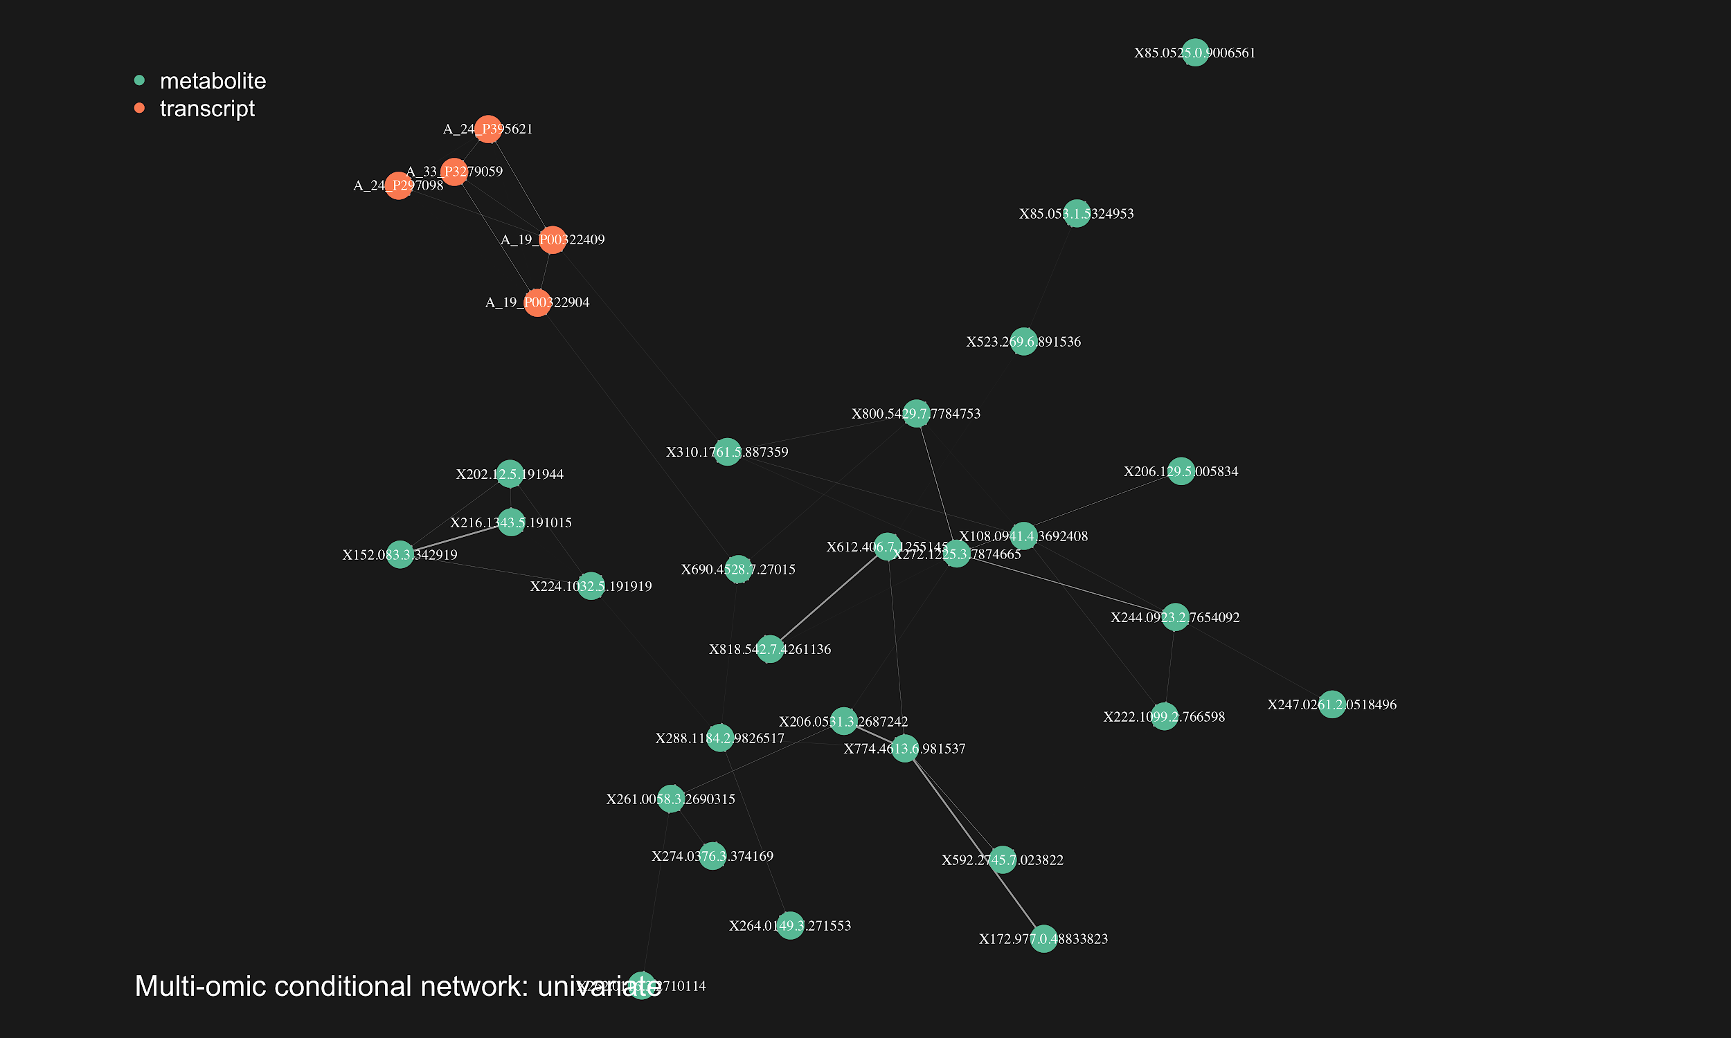
UNIVARIATE Selected variables Conditional
Only weak edges between markers in a conditional network.

Slide 34
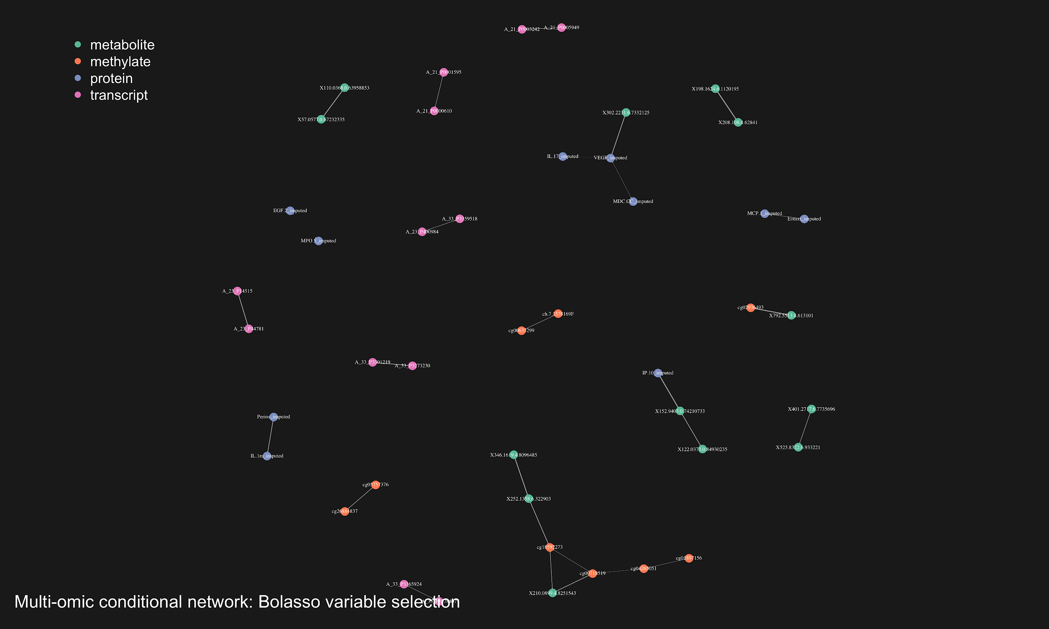
BOLASSO Conditional
Some significant inter-OMIC markers emerge
We investigated these relationships but they did not appear biologically significant

Slide 35
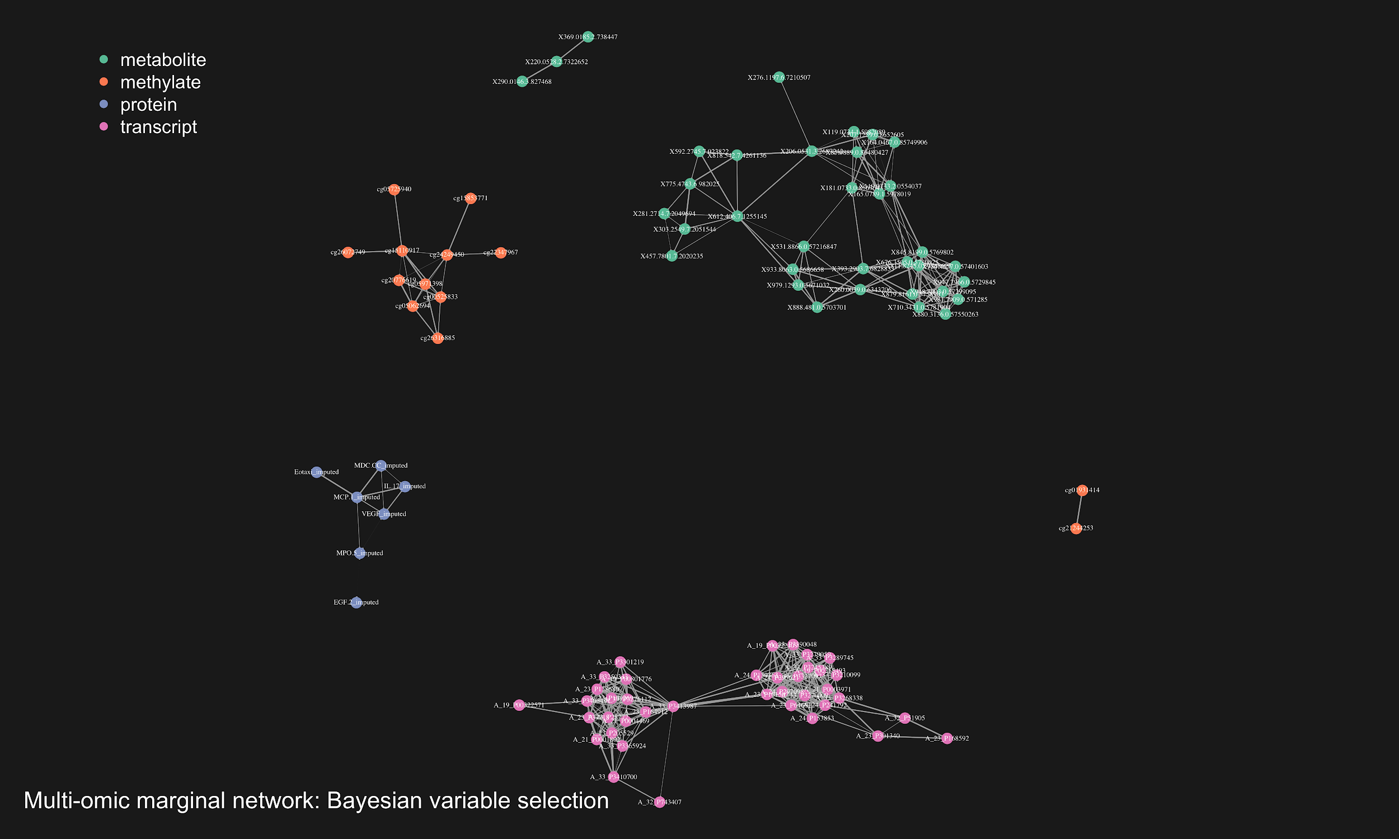
Bayesian Marginal
Similar to univariate – selected features are very highly correlated.

Slide 36
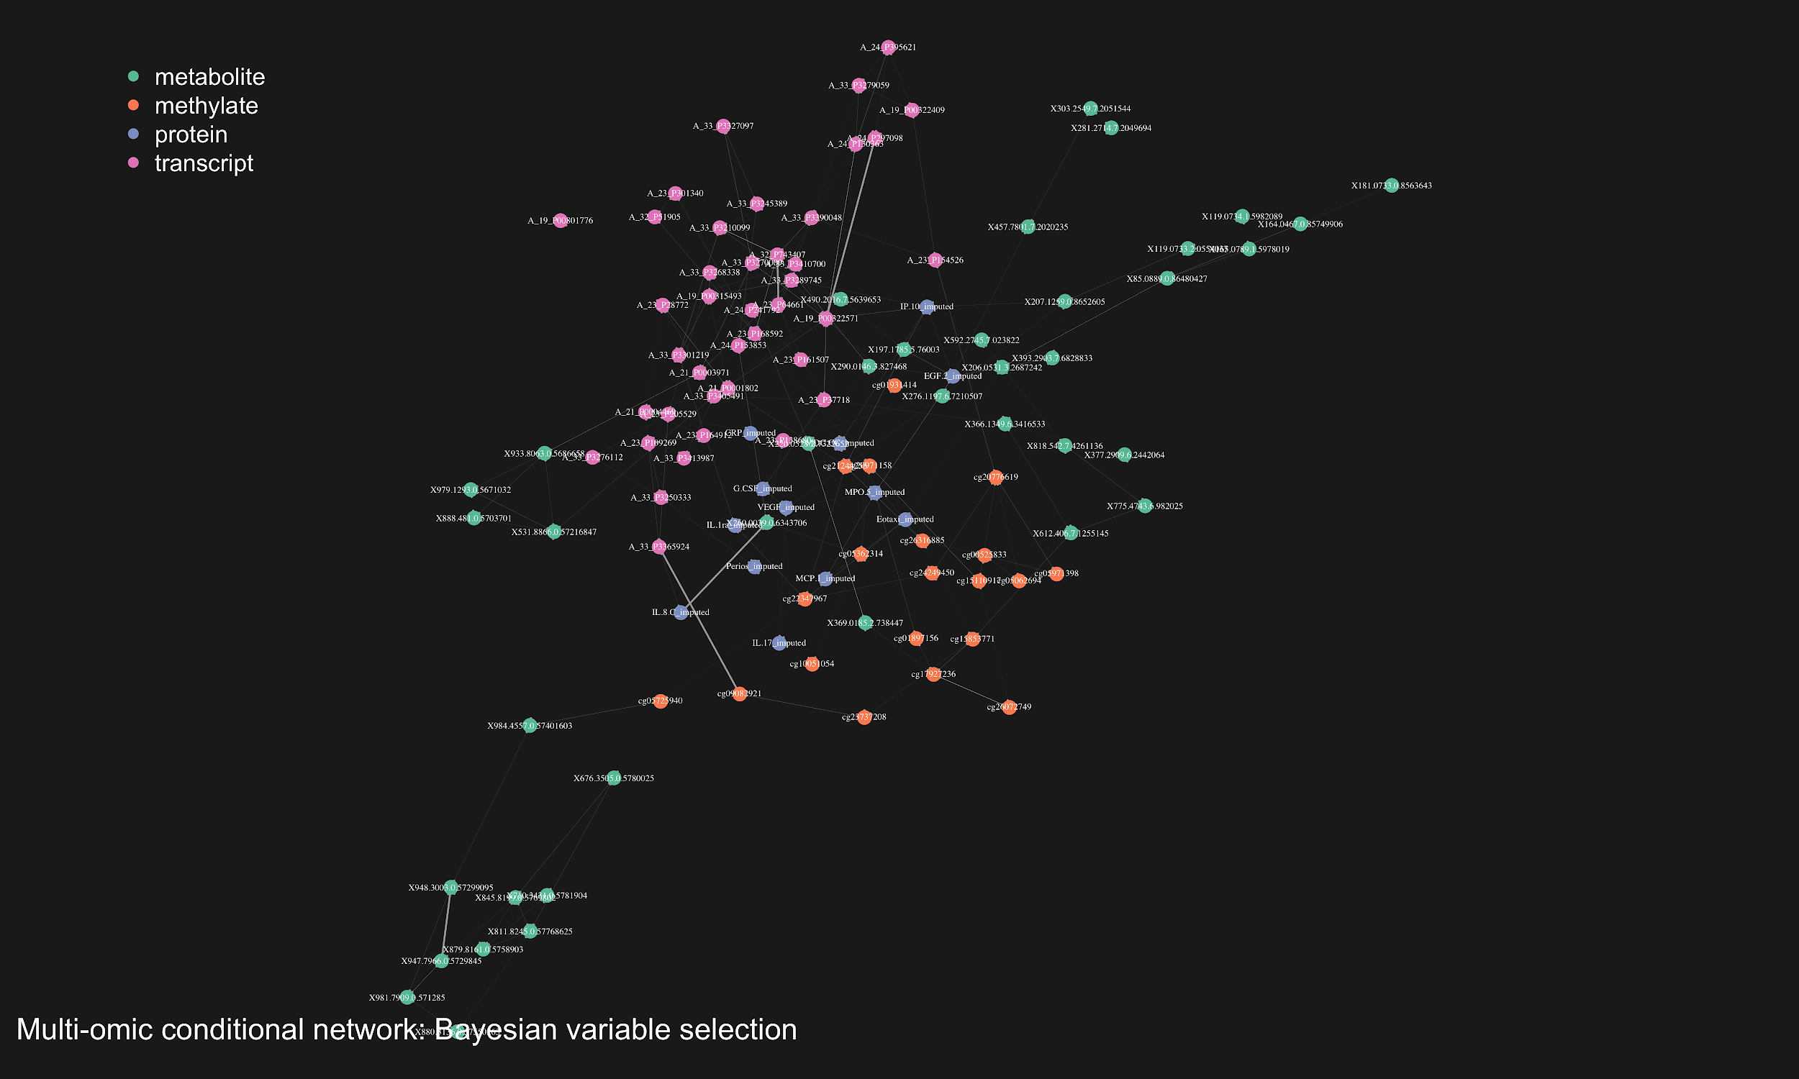
Bayesian Conditional
Stronger conditional edges than either univariate or bolasso.

Slide 37
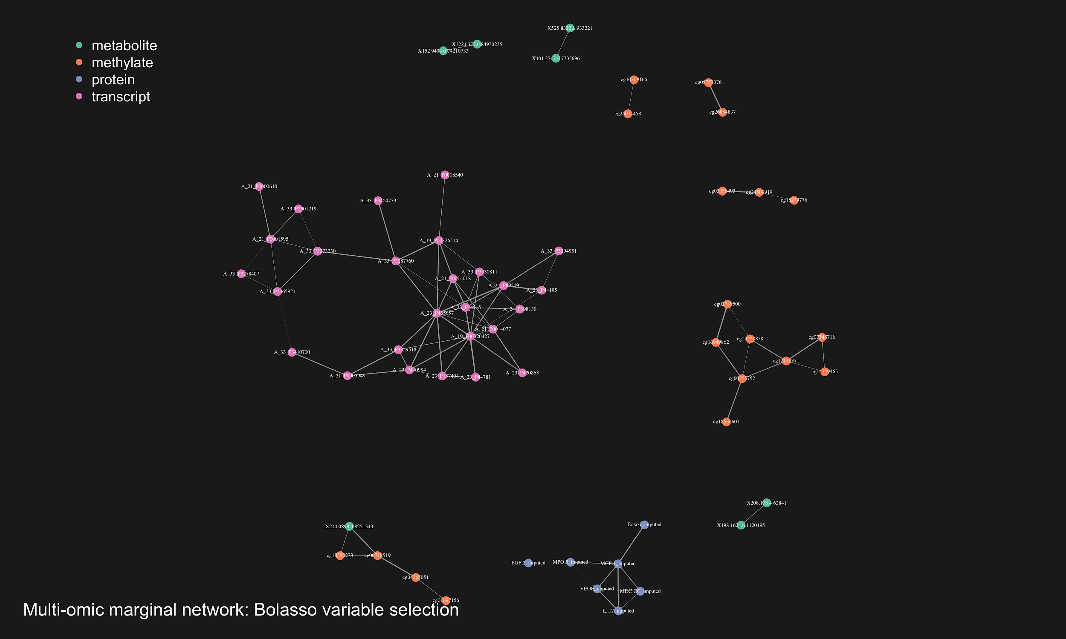
BOLASSO Marginal
Structures of correlation between markers, but much lower level of transitivity than univariate selected variables
Lower clustering coefficient

Slide 38
Conclusion
Some ‘interesting’ markers were identified by multivariate methods that were not identified by univariate methods
Network analysis reveals how the interrelationships between selected markers are very different depending on method of variable selection.
Using multivariate methods of feature selection to complement univariate methods helps pick up ‘interesting’ features that may not have been picked up in univariate analysis.
Further enquiry:
all methods used model linear relationships. Non-linear models (eg GAM) may enrich analysis.
Stratification

Slide 39
Thank you!

Slide 40
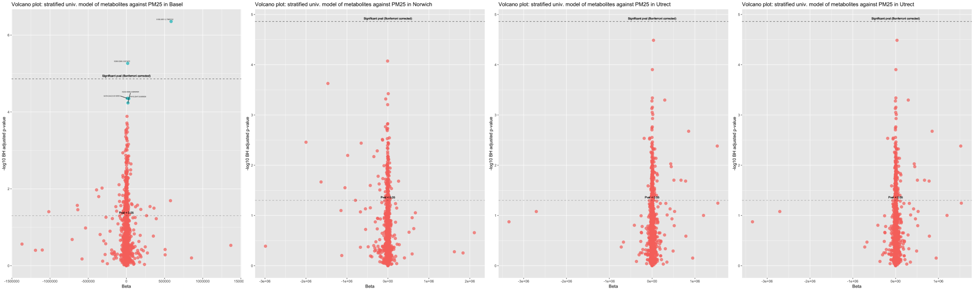
Stratification

